Slide 1

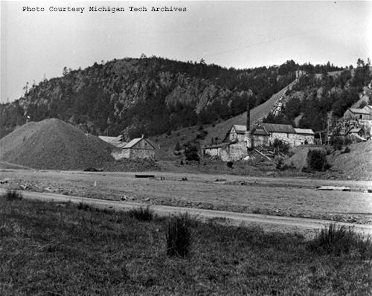
Cliff mine and
Cornish mines
An exposure to geology, history,
and industrial architecture...

Slide 2
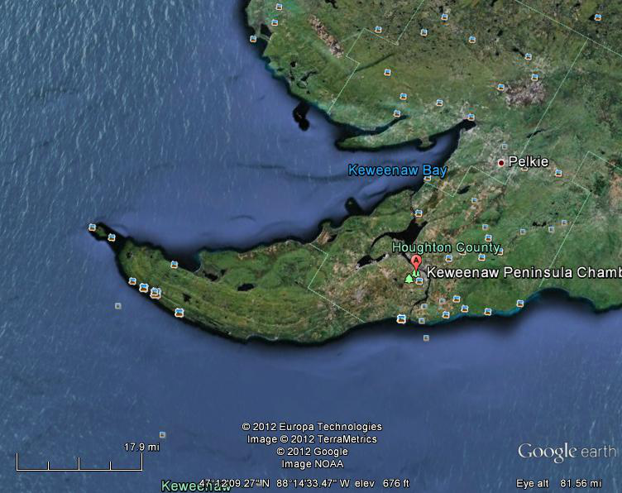
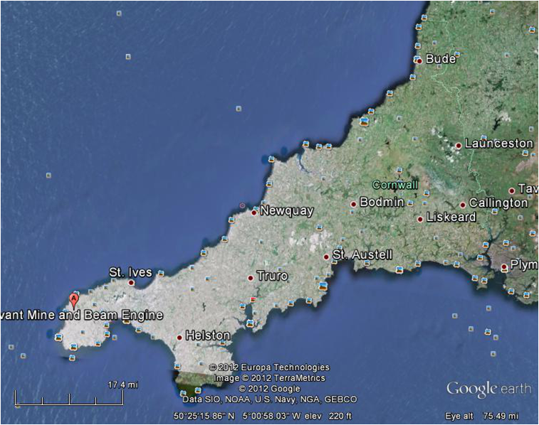
Keweenaw and Cornwall
Keewenaw
Cornwall

Slide 3
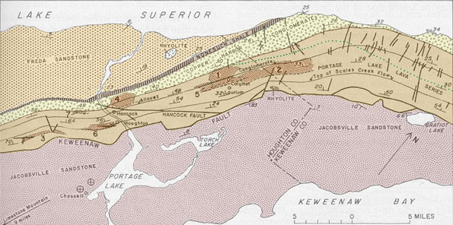
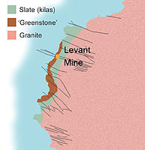
Geology

Slide 4
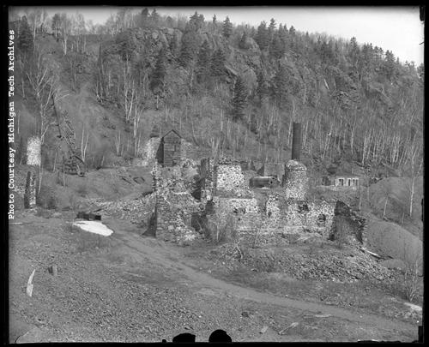
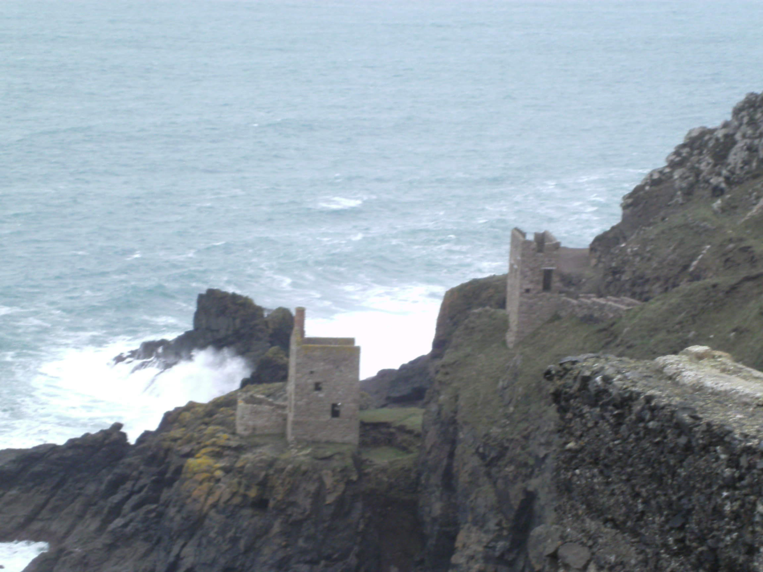
Mines on cliff faces
Botallack mine,
Cornwall
Cliff mine, Mi

Slide 5
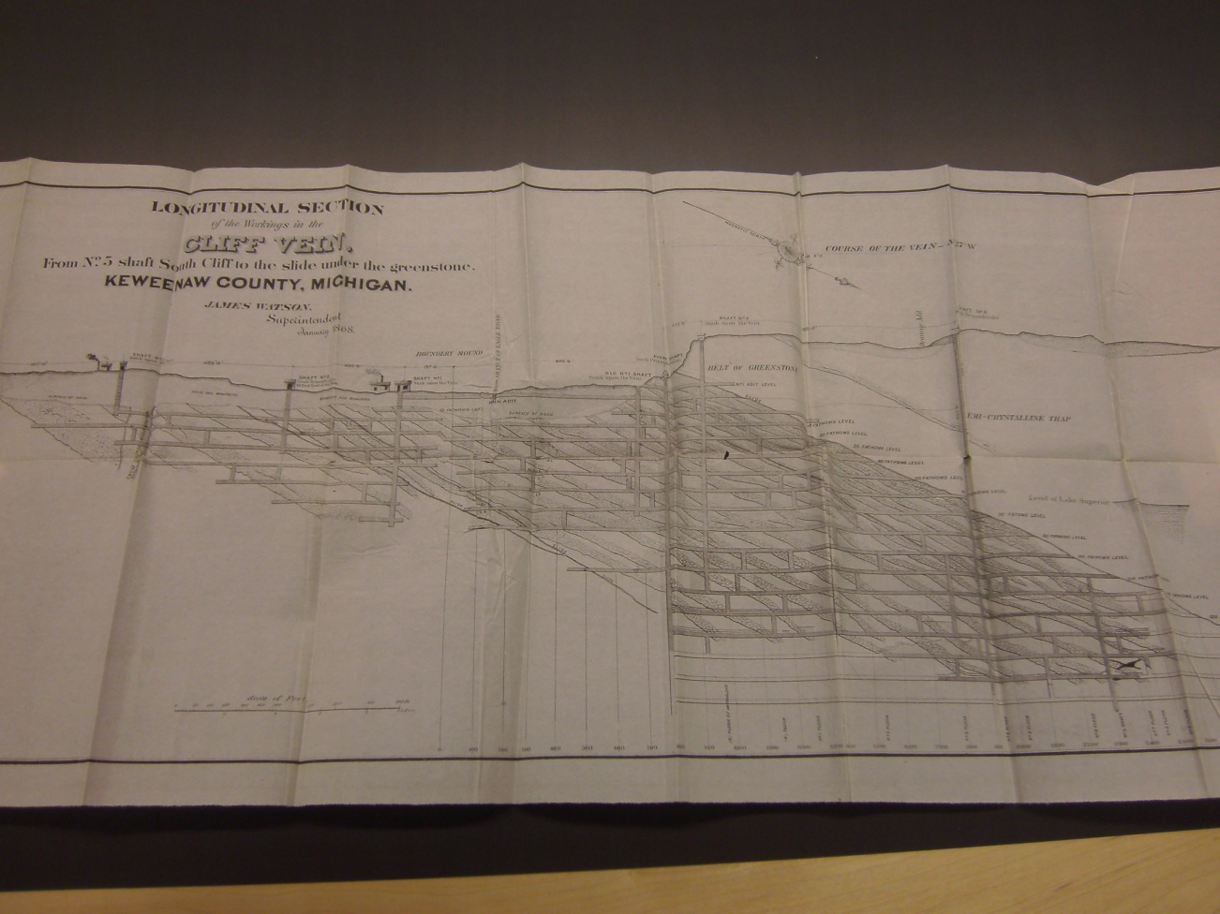
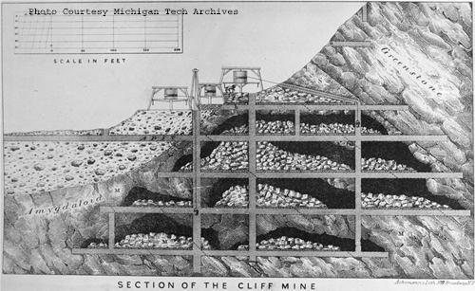
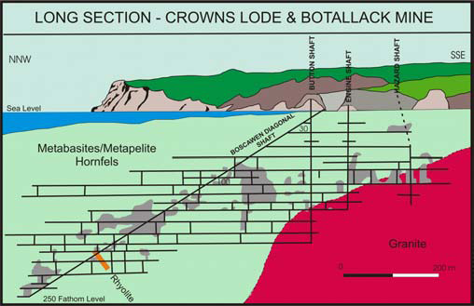
Underground

Slide 6
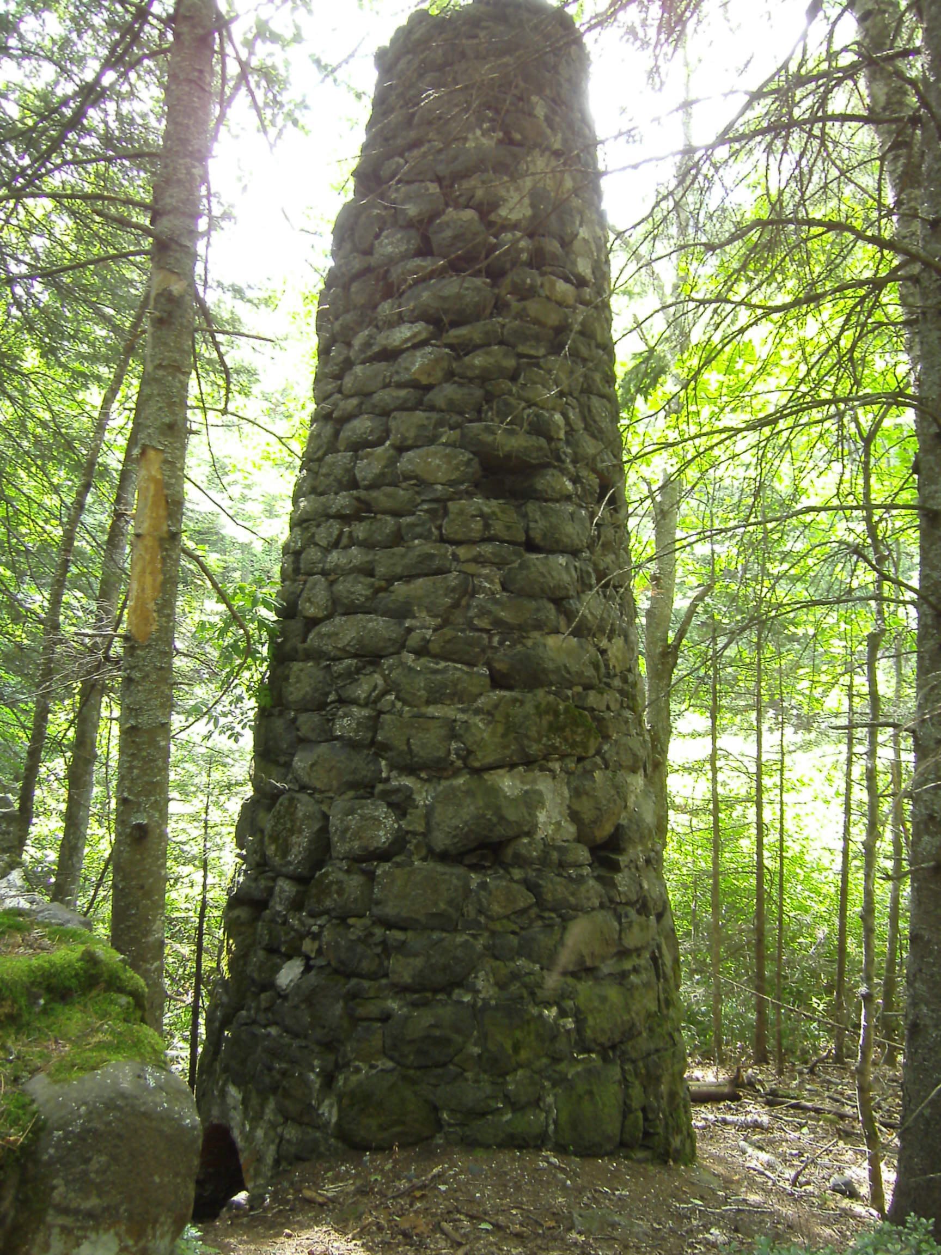
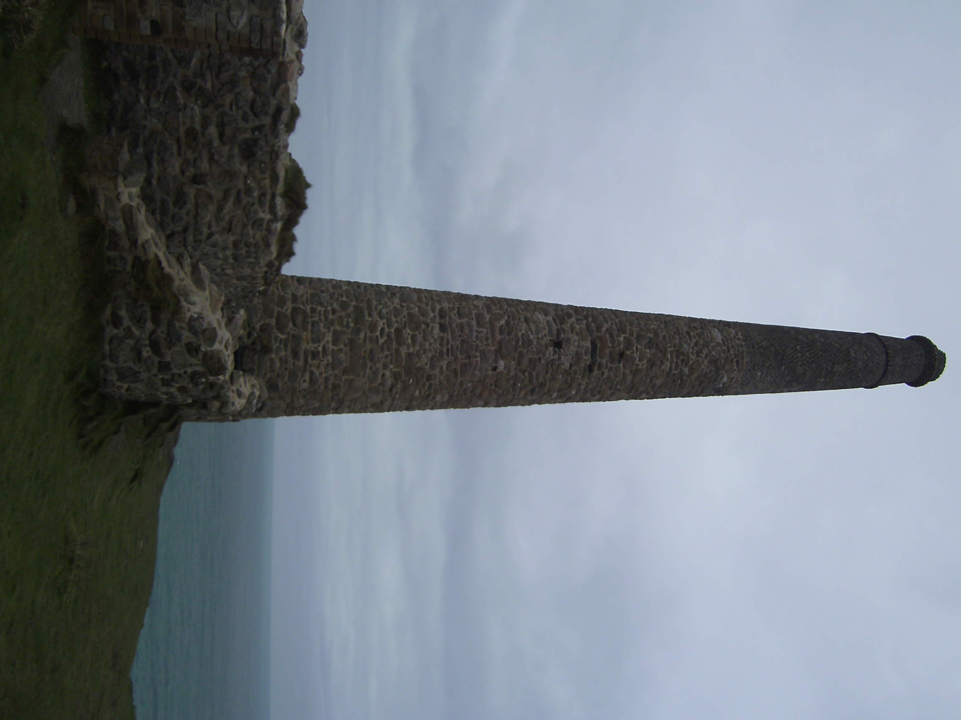
Engine house chimneys
Keewenaw
Cornwall

Slide 7
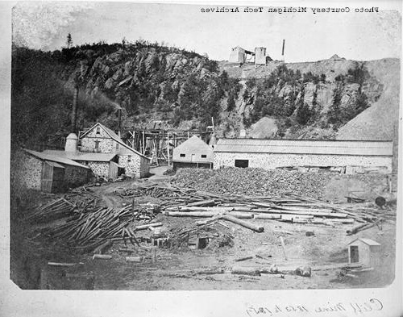
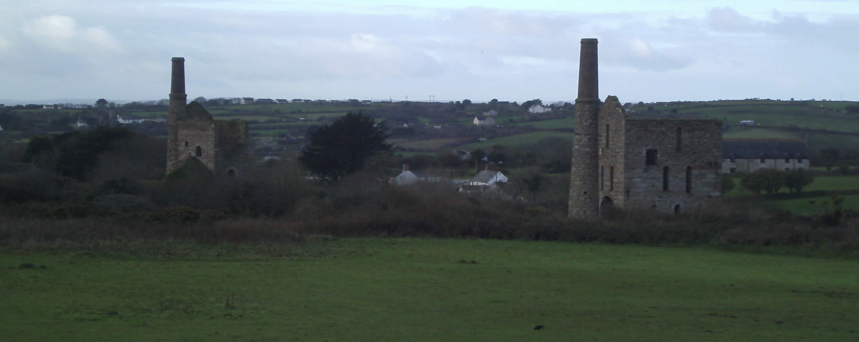
Engine houses
Keewenaw
Cornwall

Slide 8
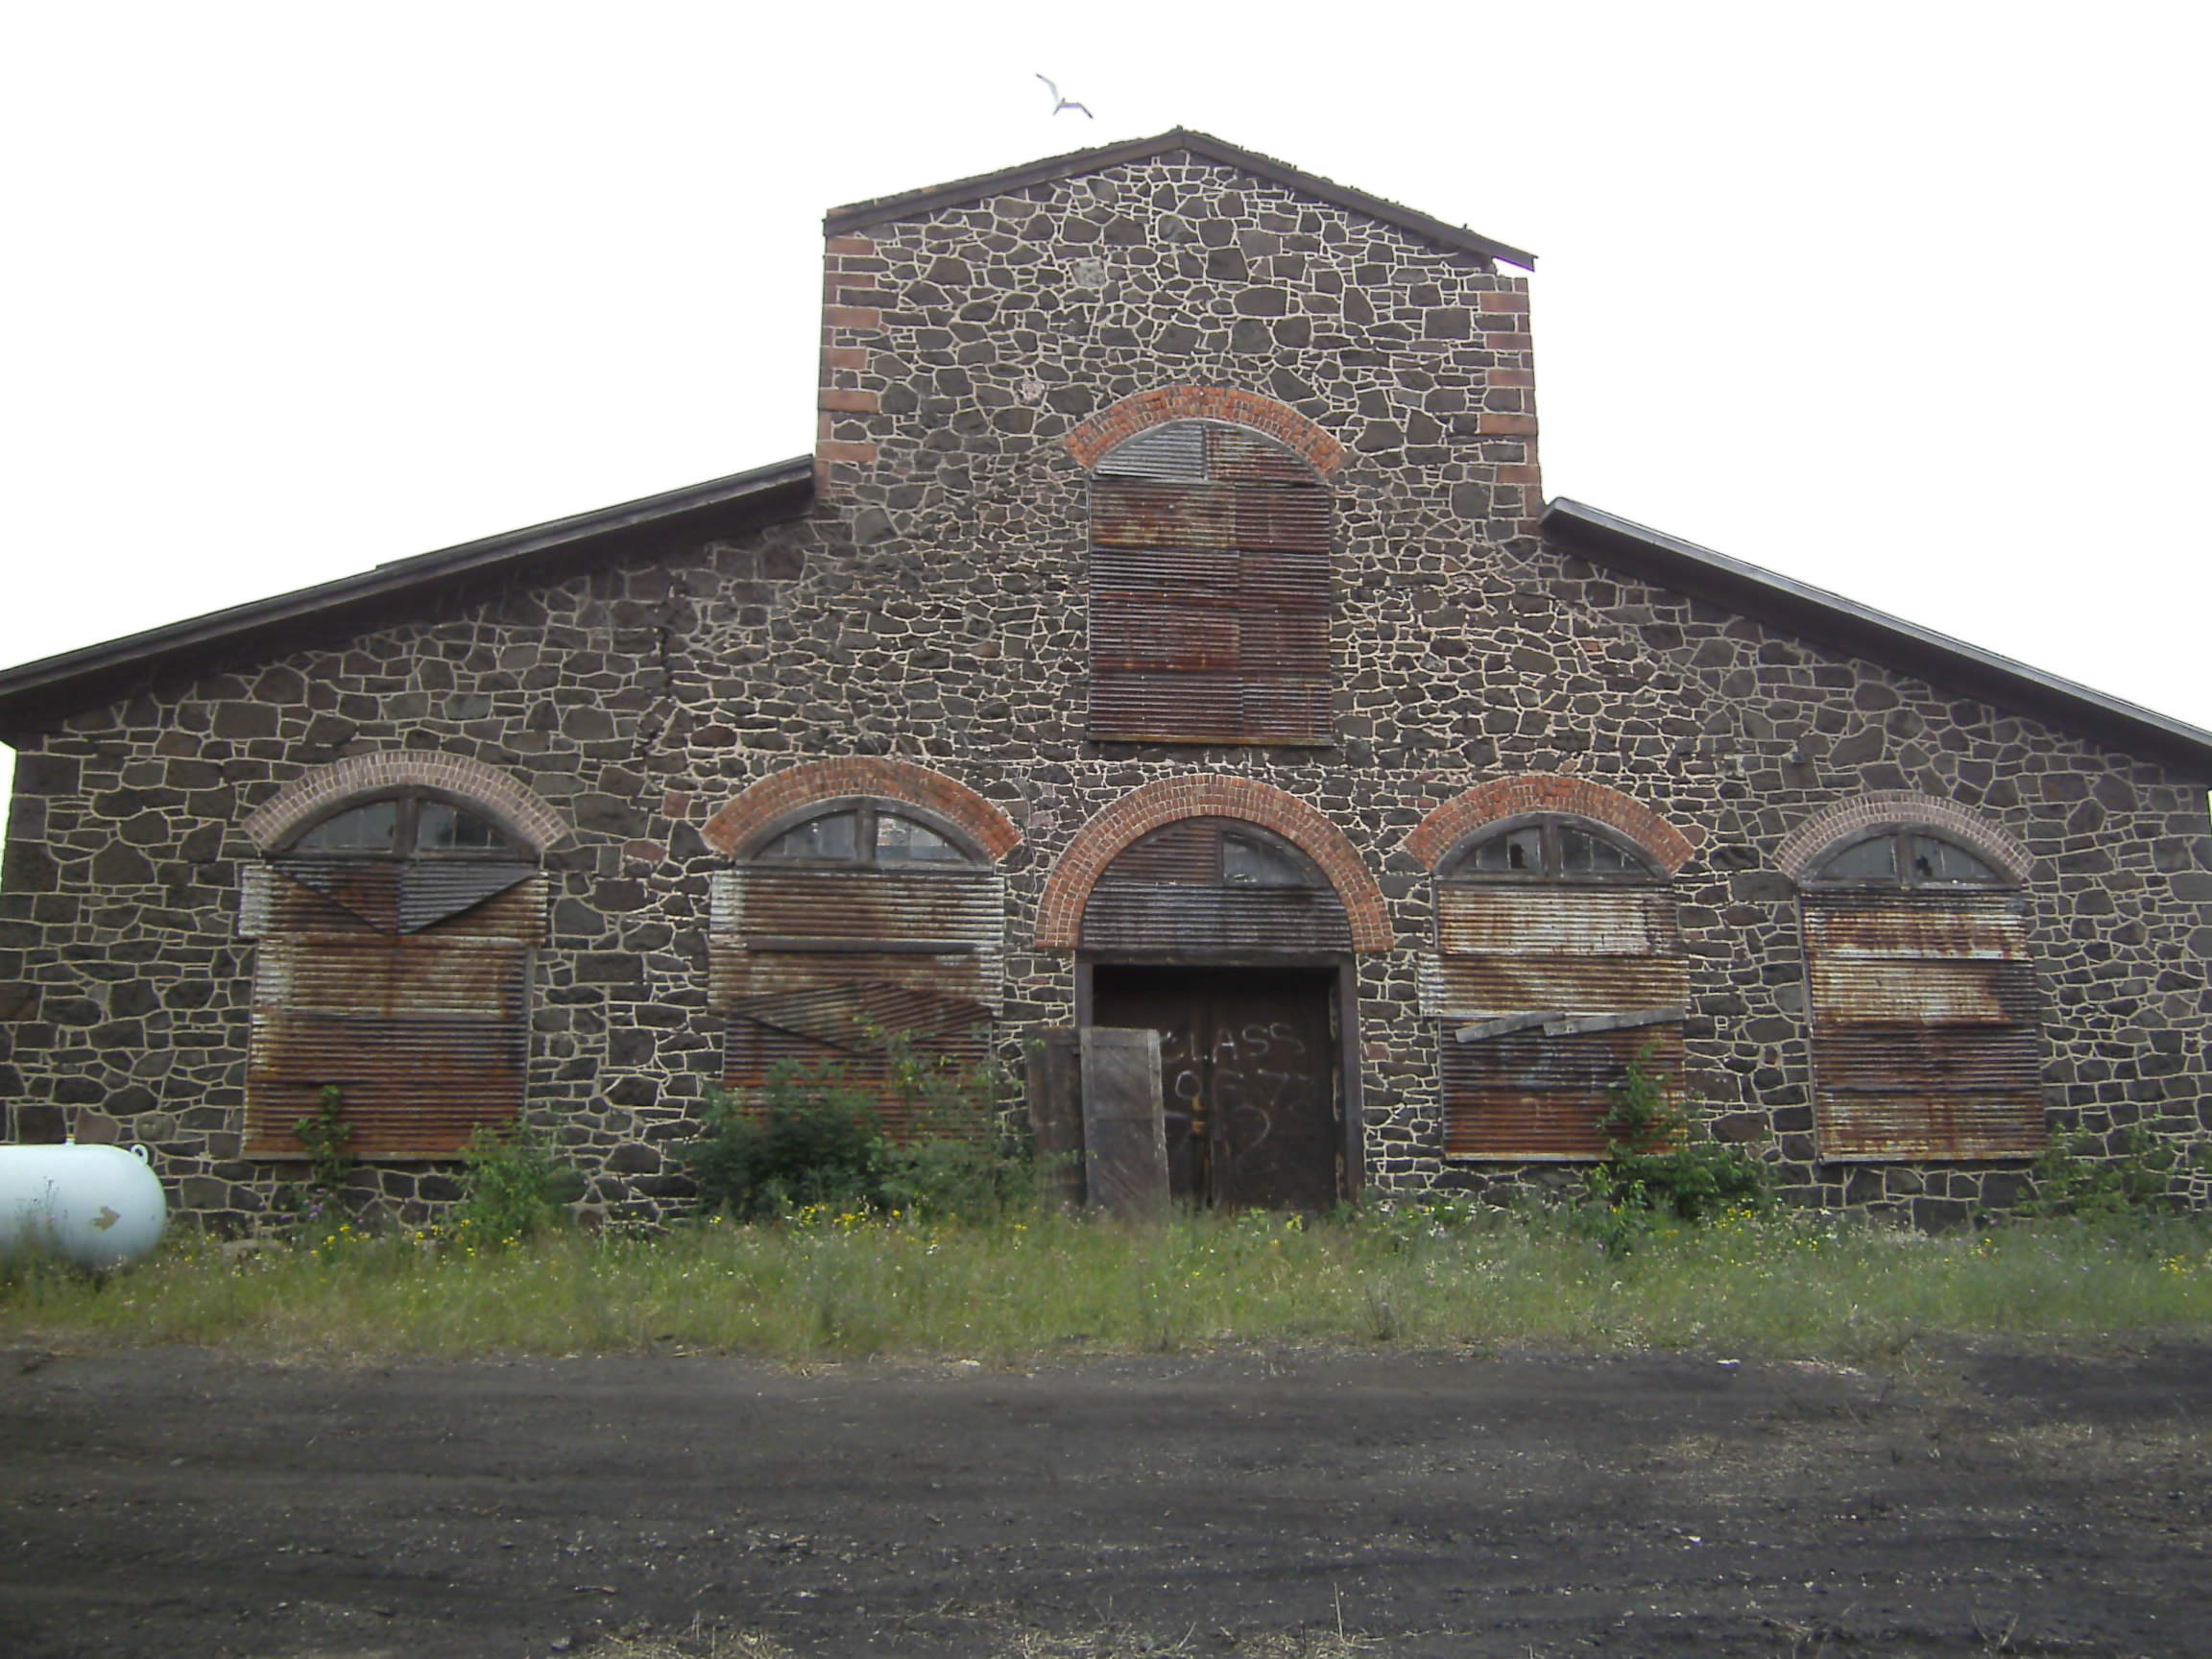
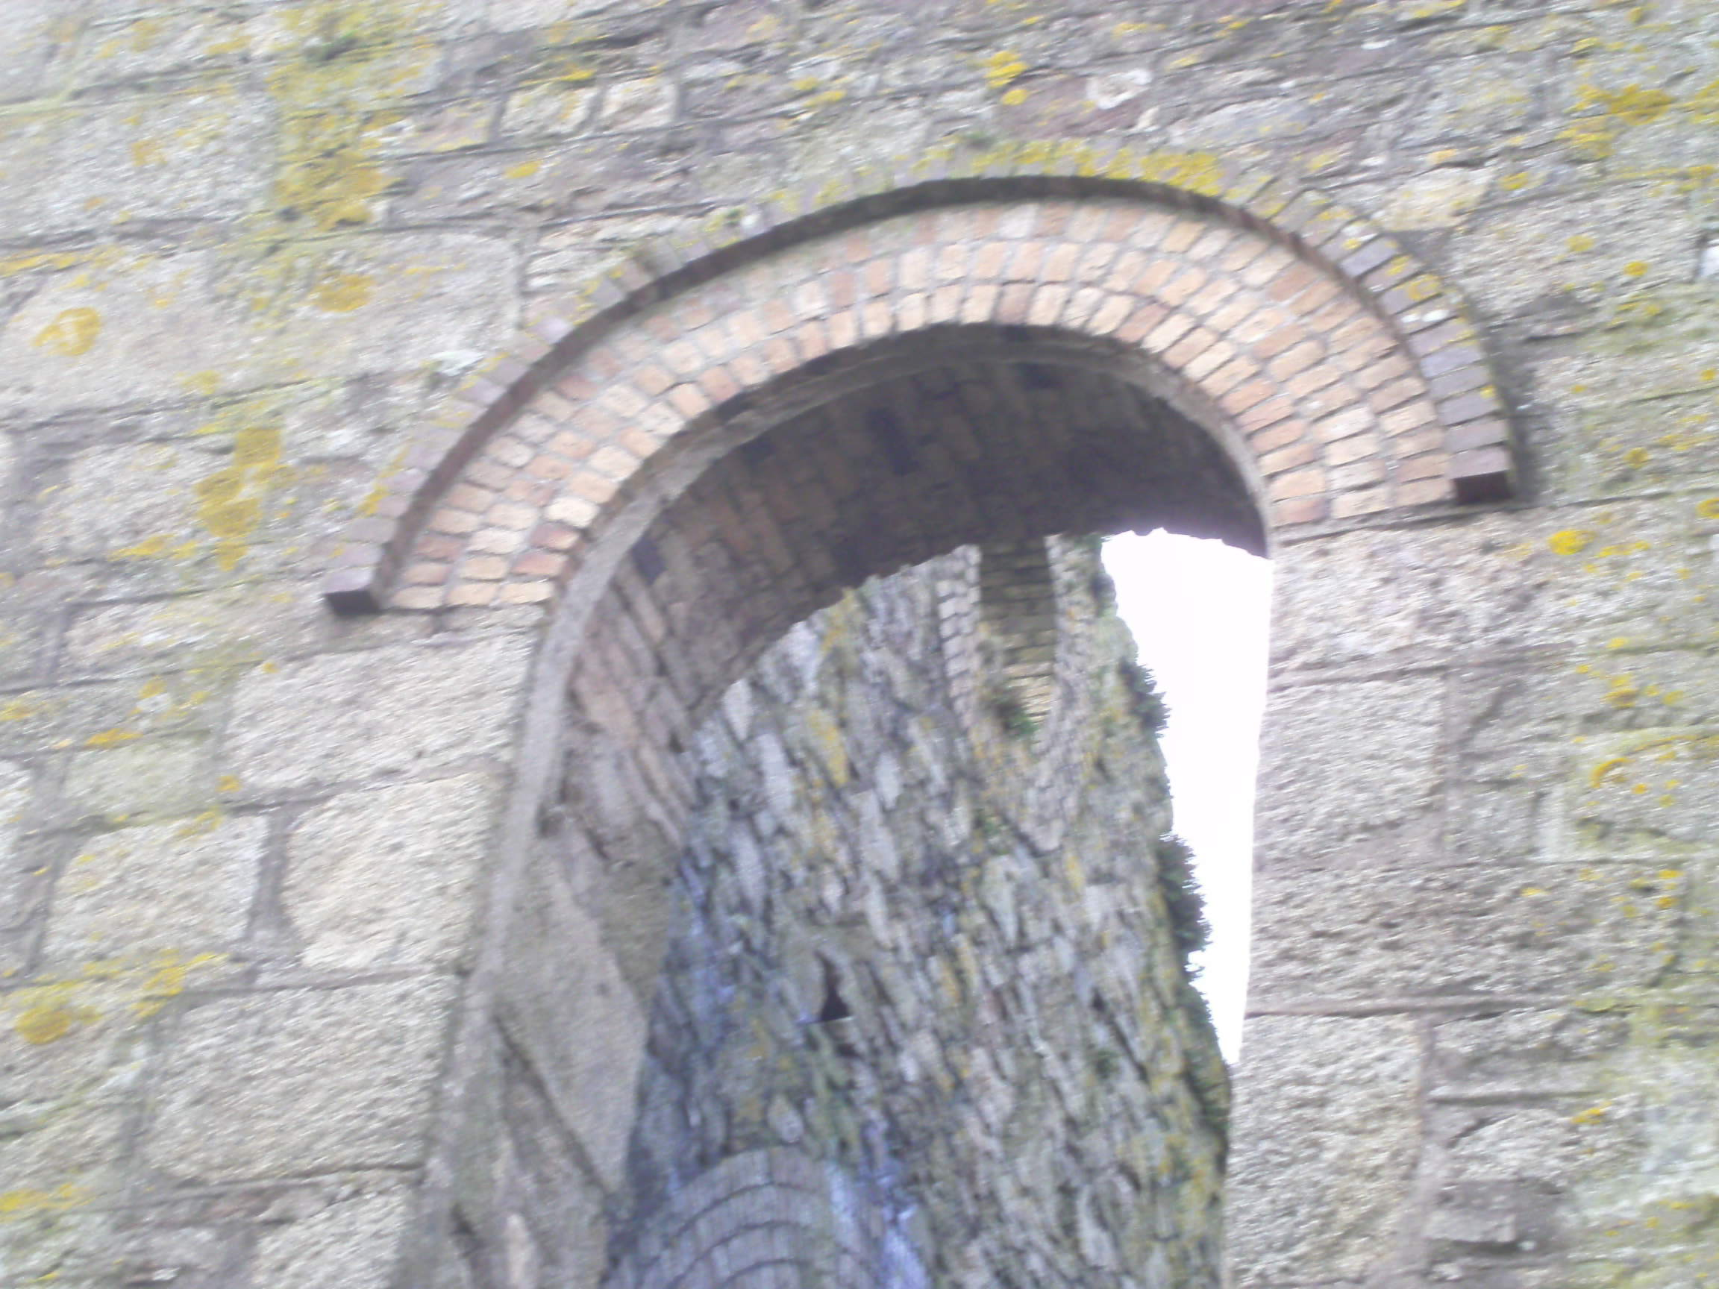
Brickwork archways
Keewenaw
Cornwall

Slide 9
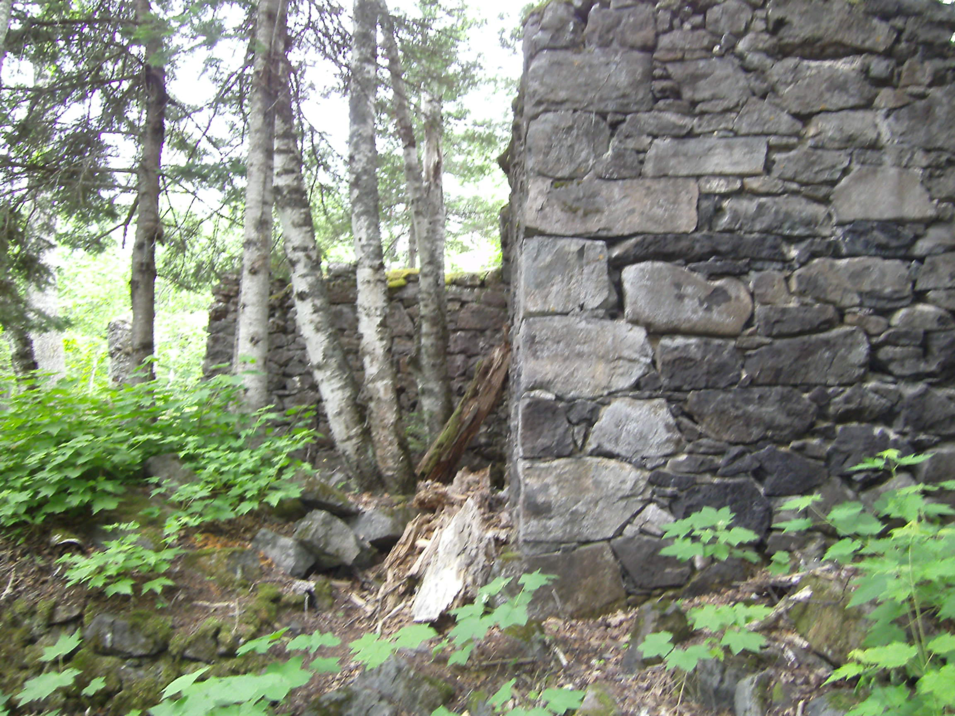
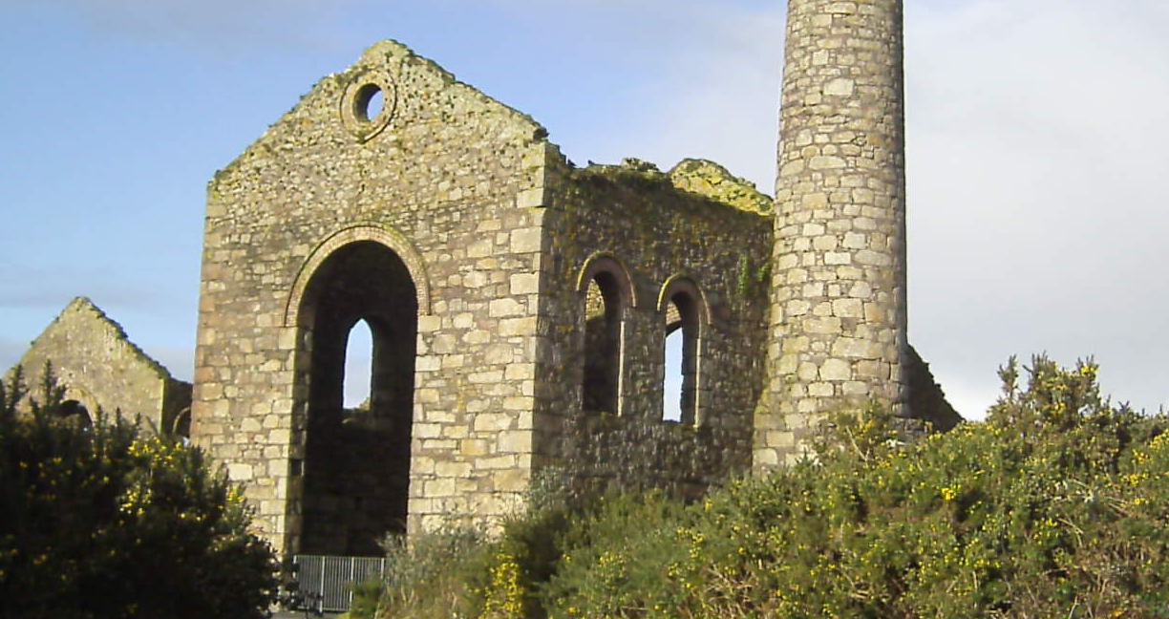
Corner details
Cornwall
Keewenaw

Slide 10
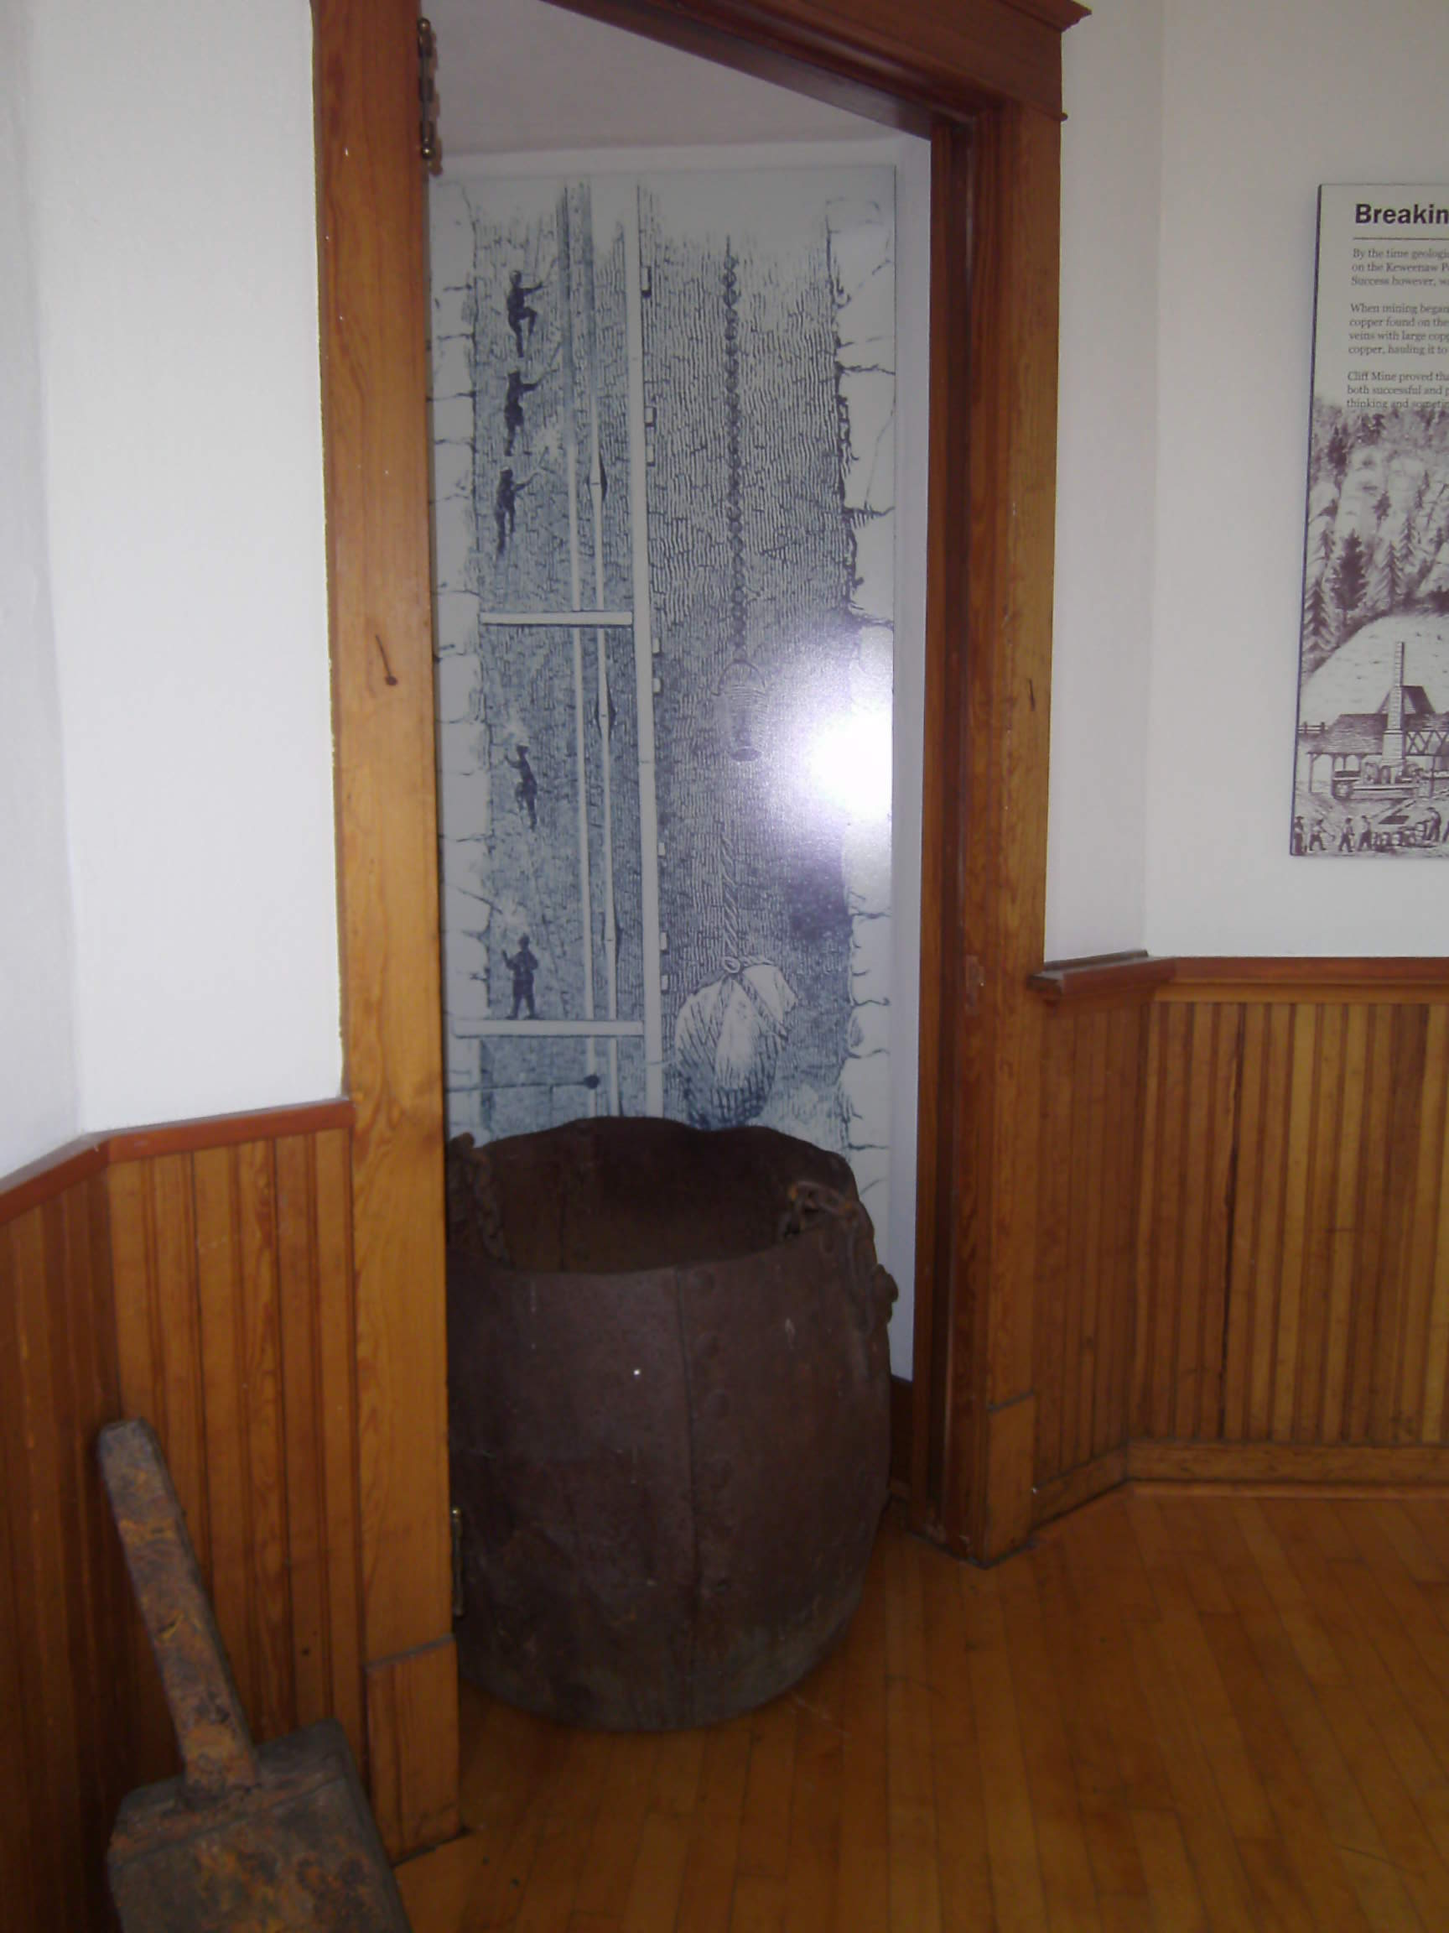
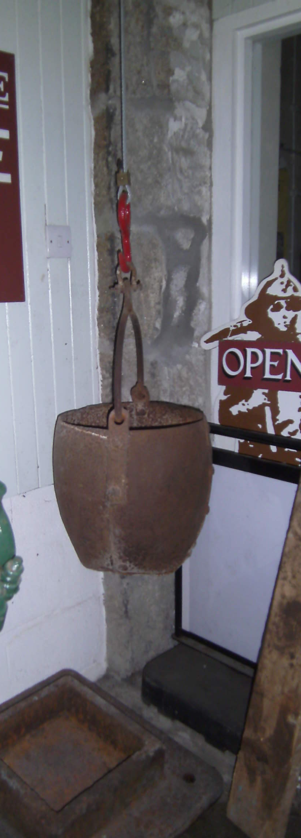
Kibbles (hoisting buckets)
Cornwall
Keewenaw

Slide 11
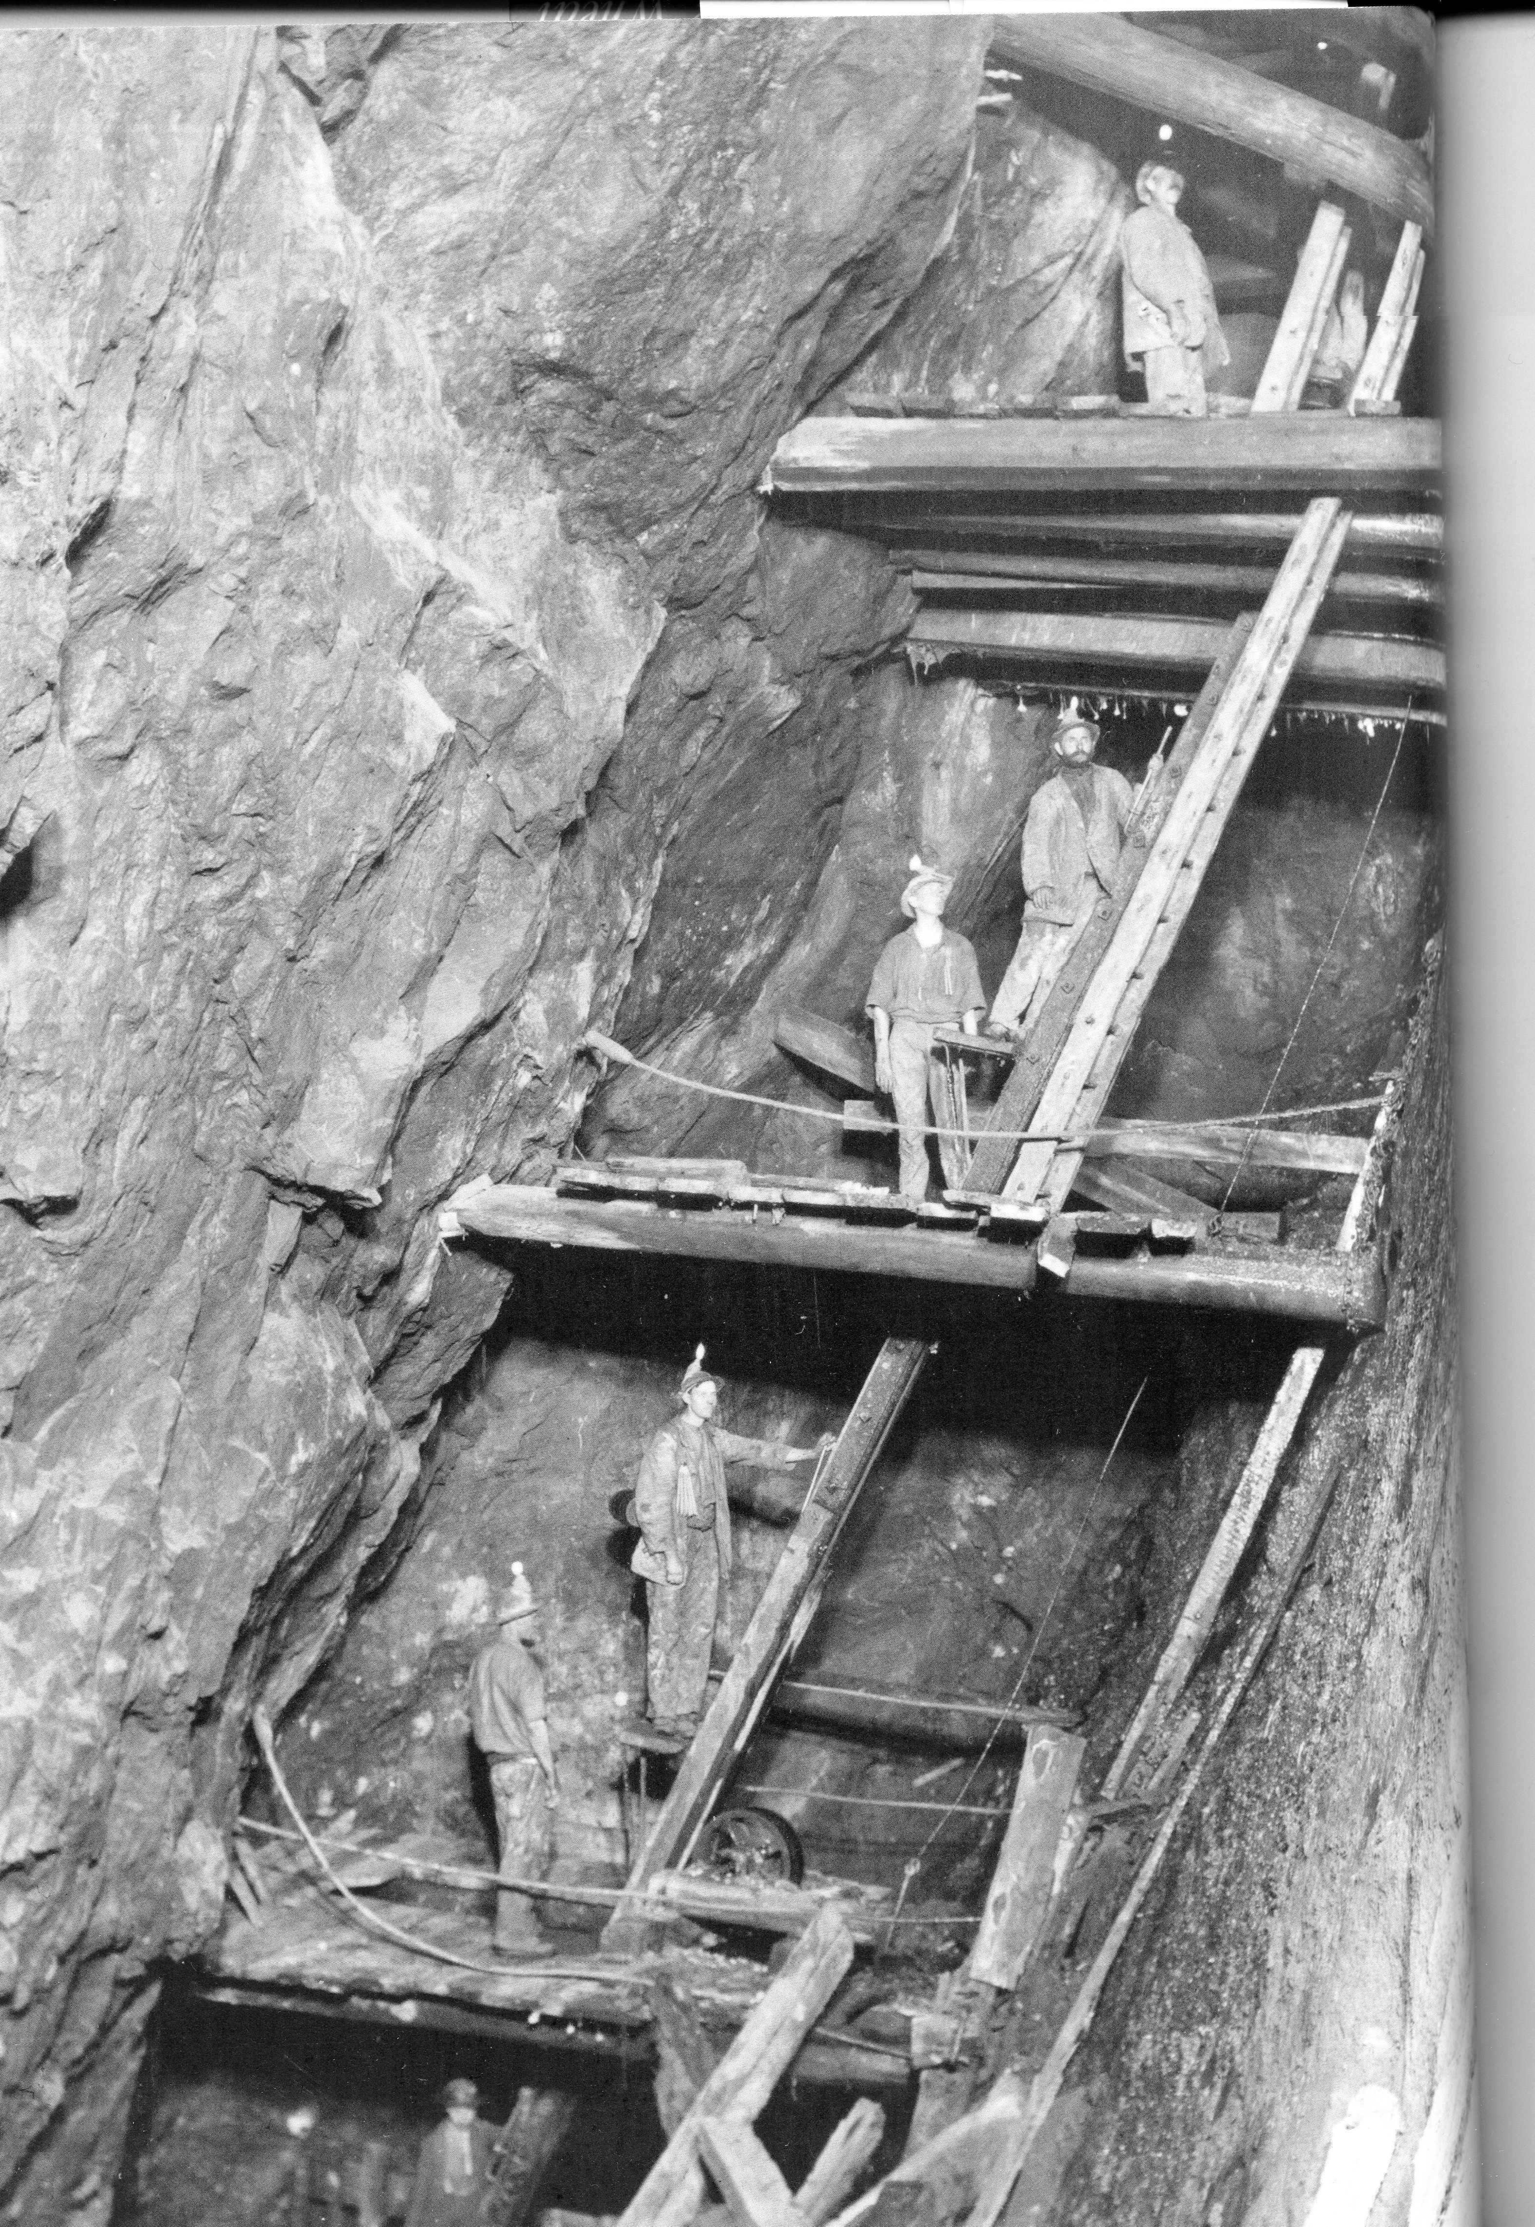
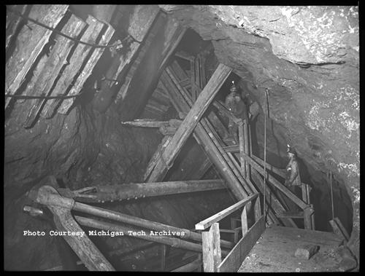
Man engine
Cornwall
Keewenaw

Slide 12
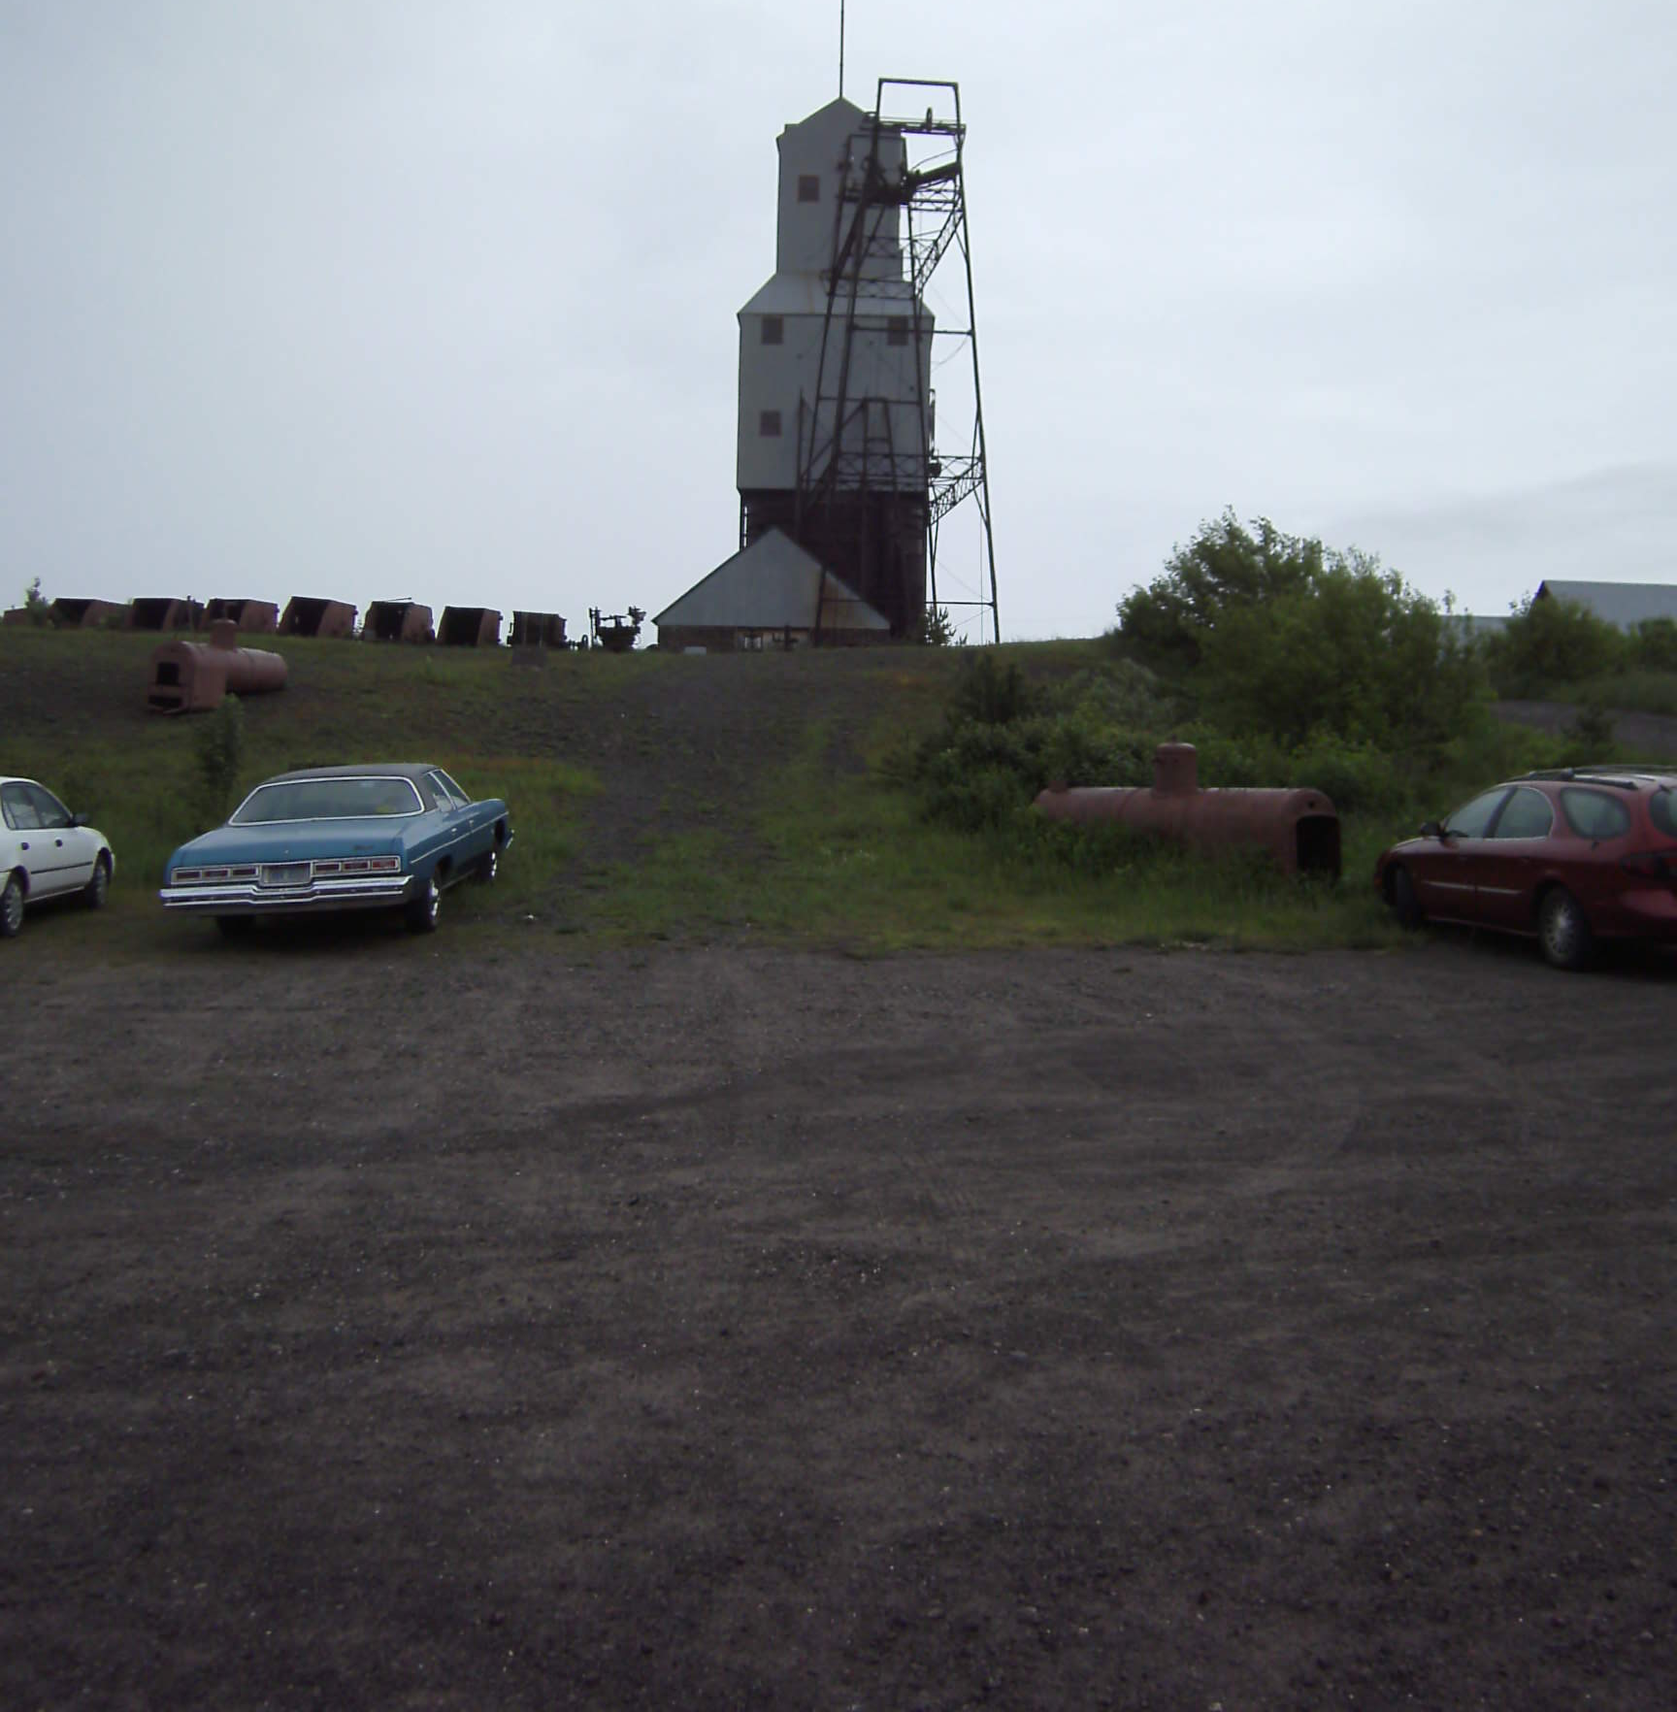
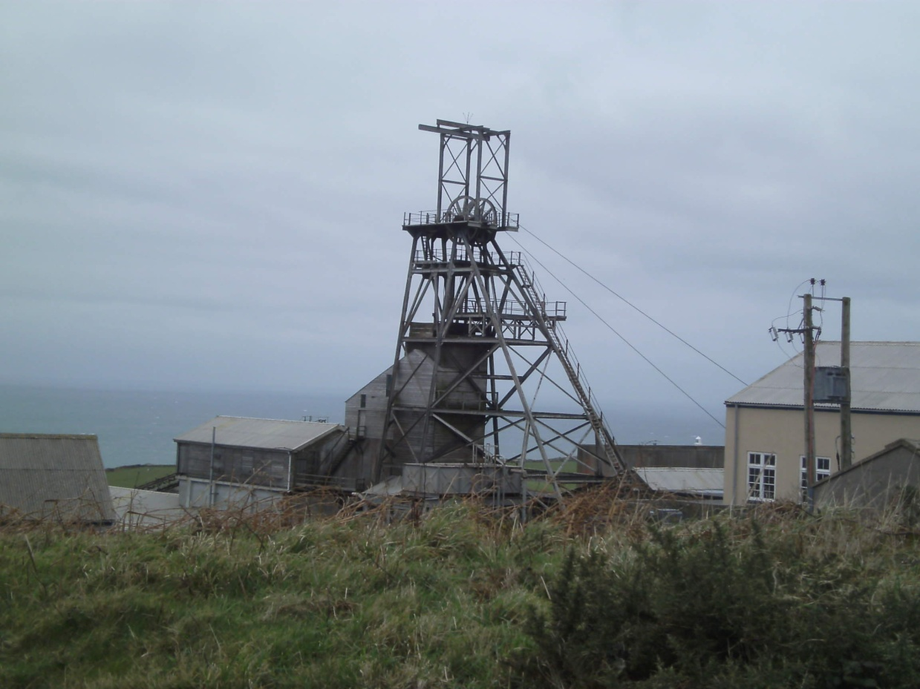
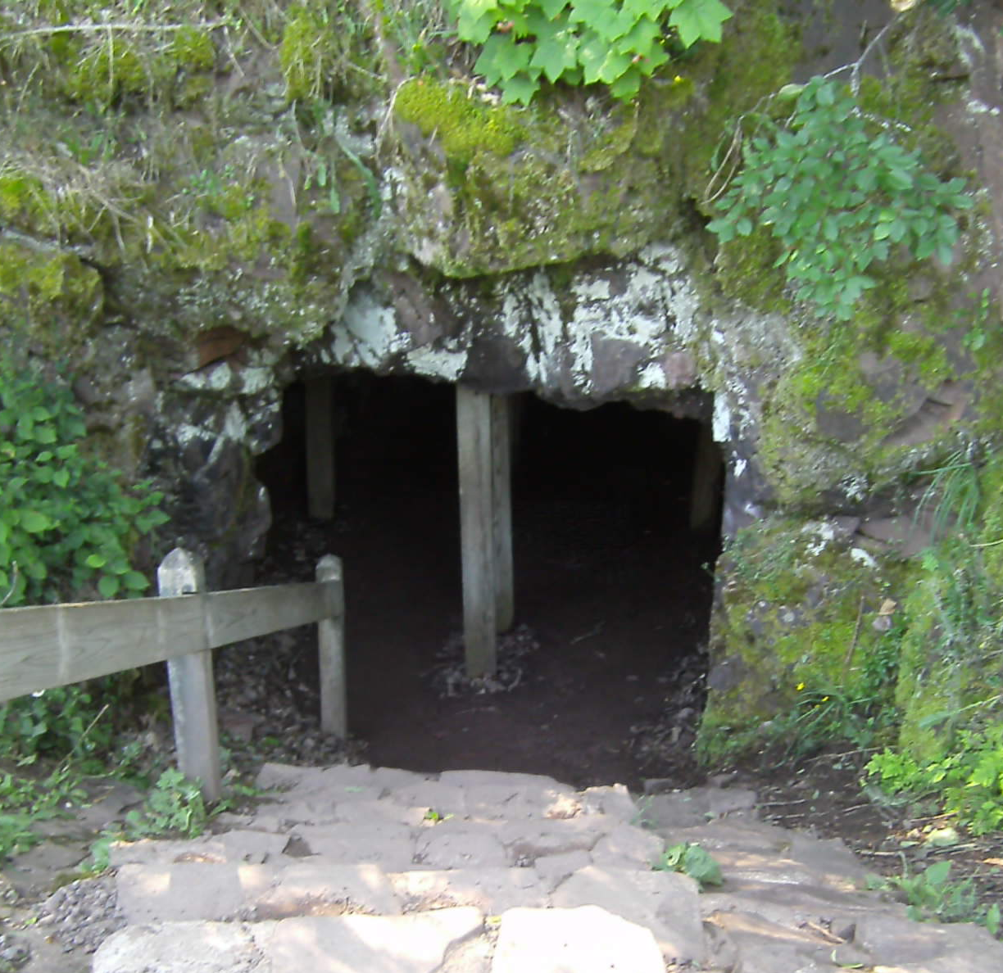
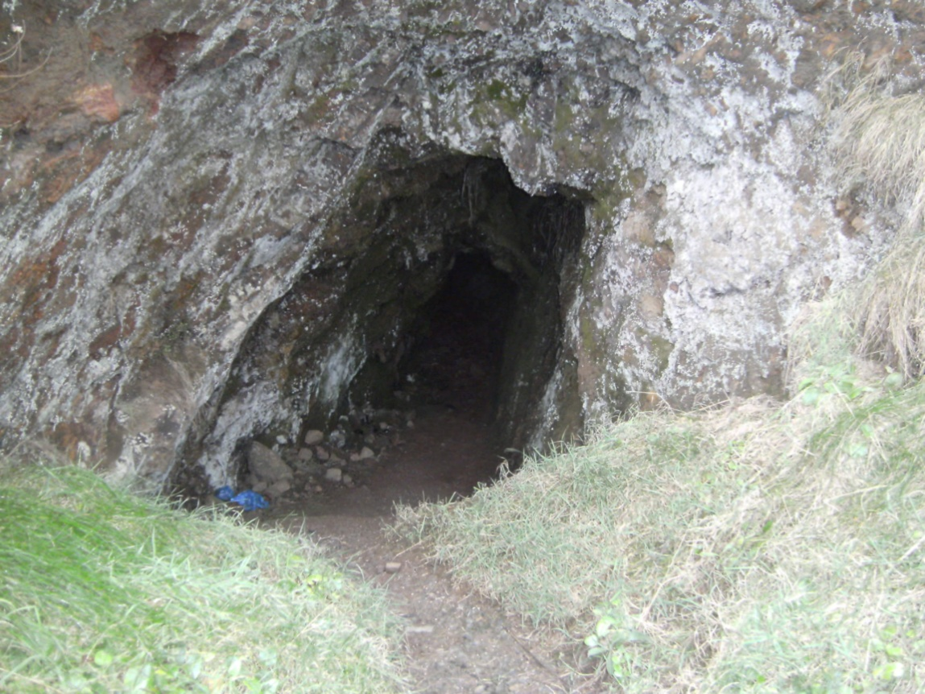
Mine entrances
Cornwall
Keewenaw

Slide 13
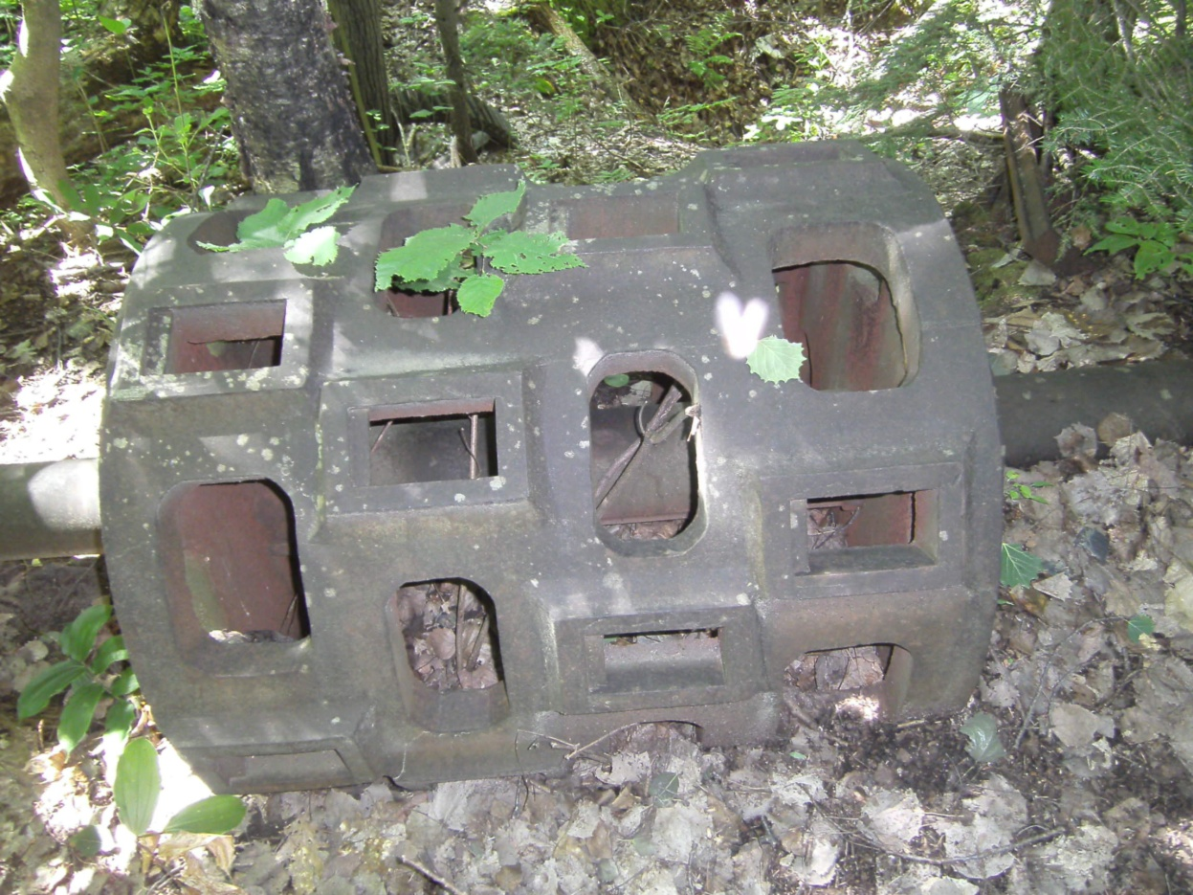
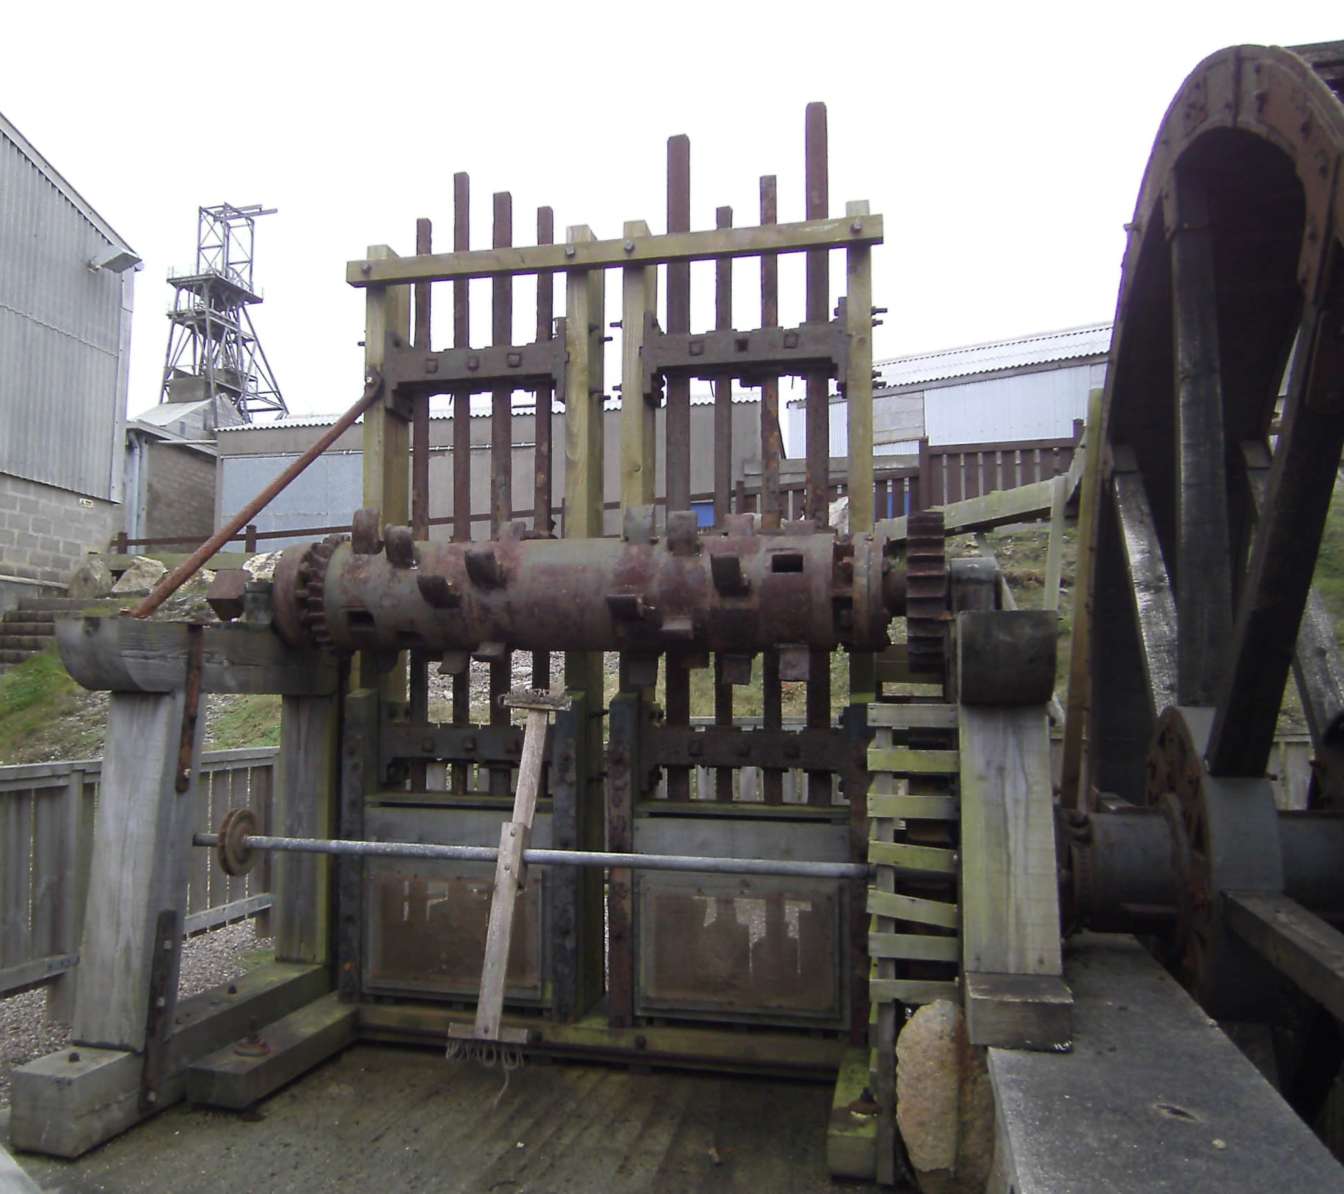
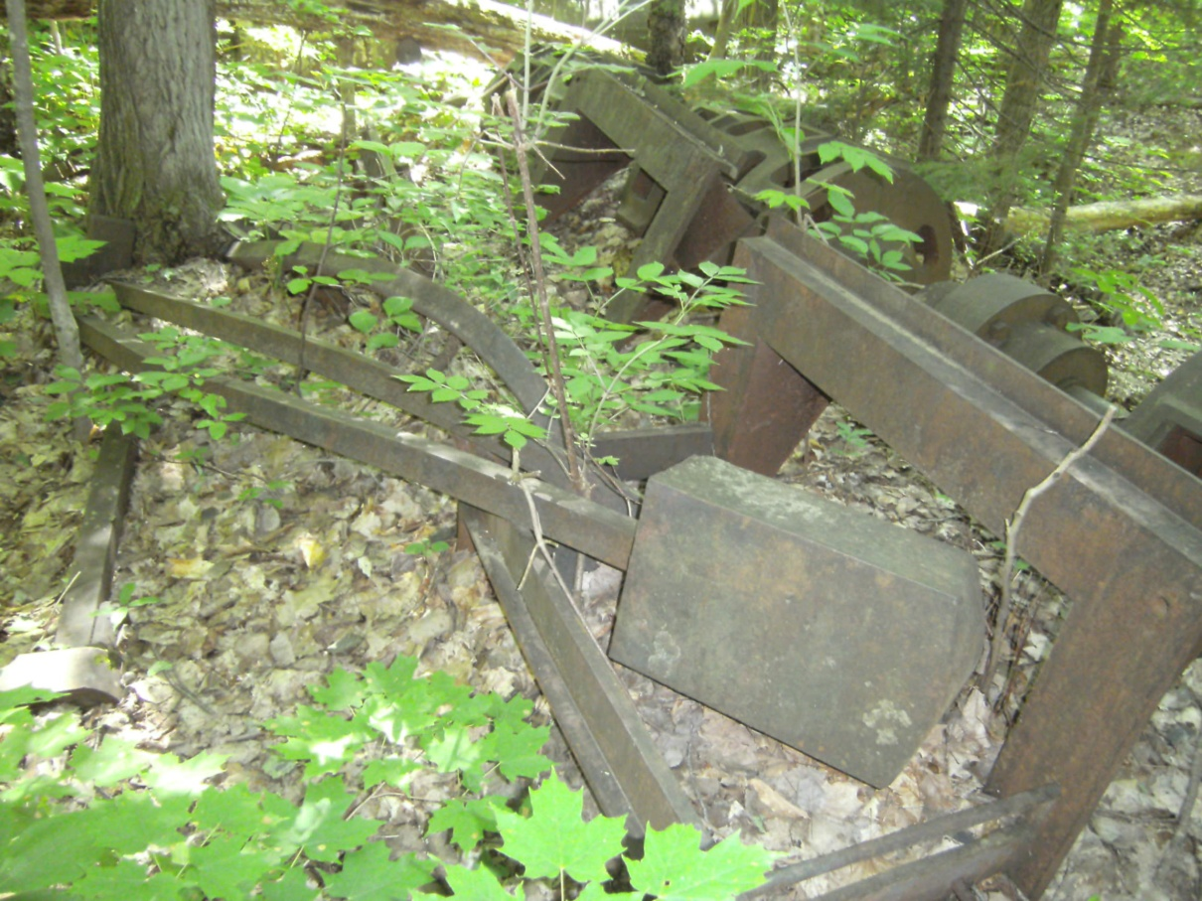
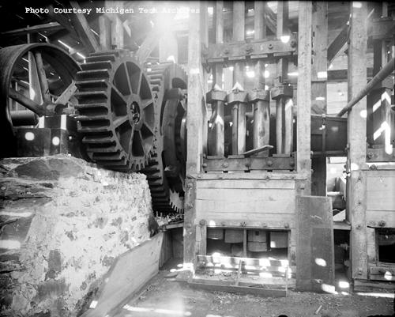
Stamps
Cornwall
Keewenaw

Slide 14
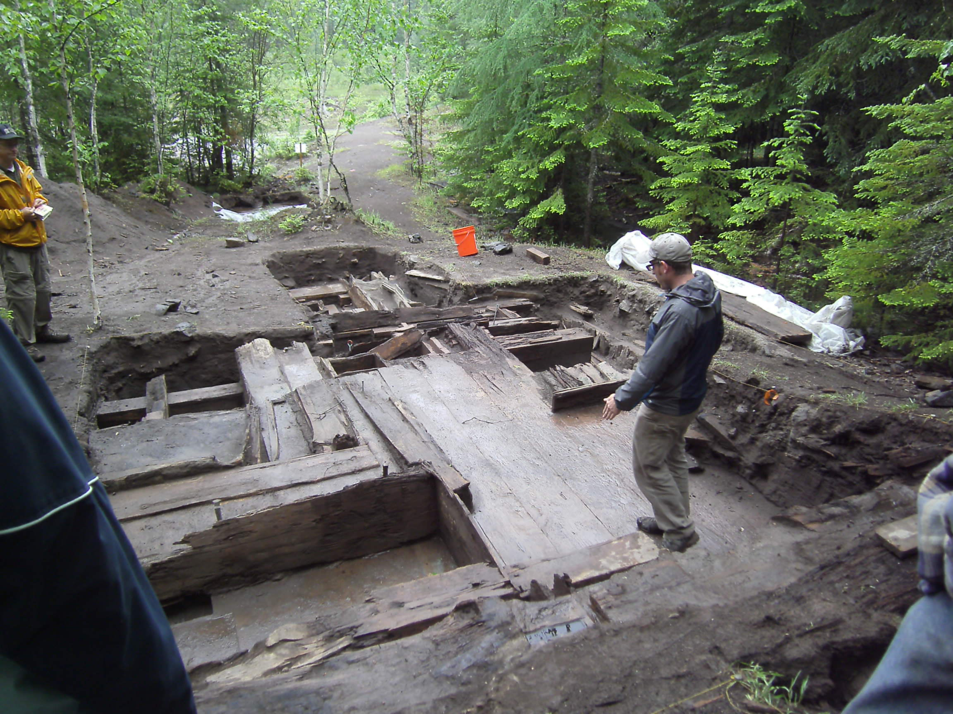
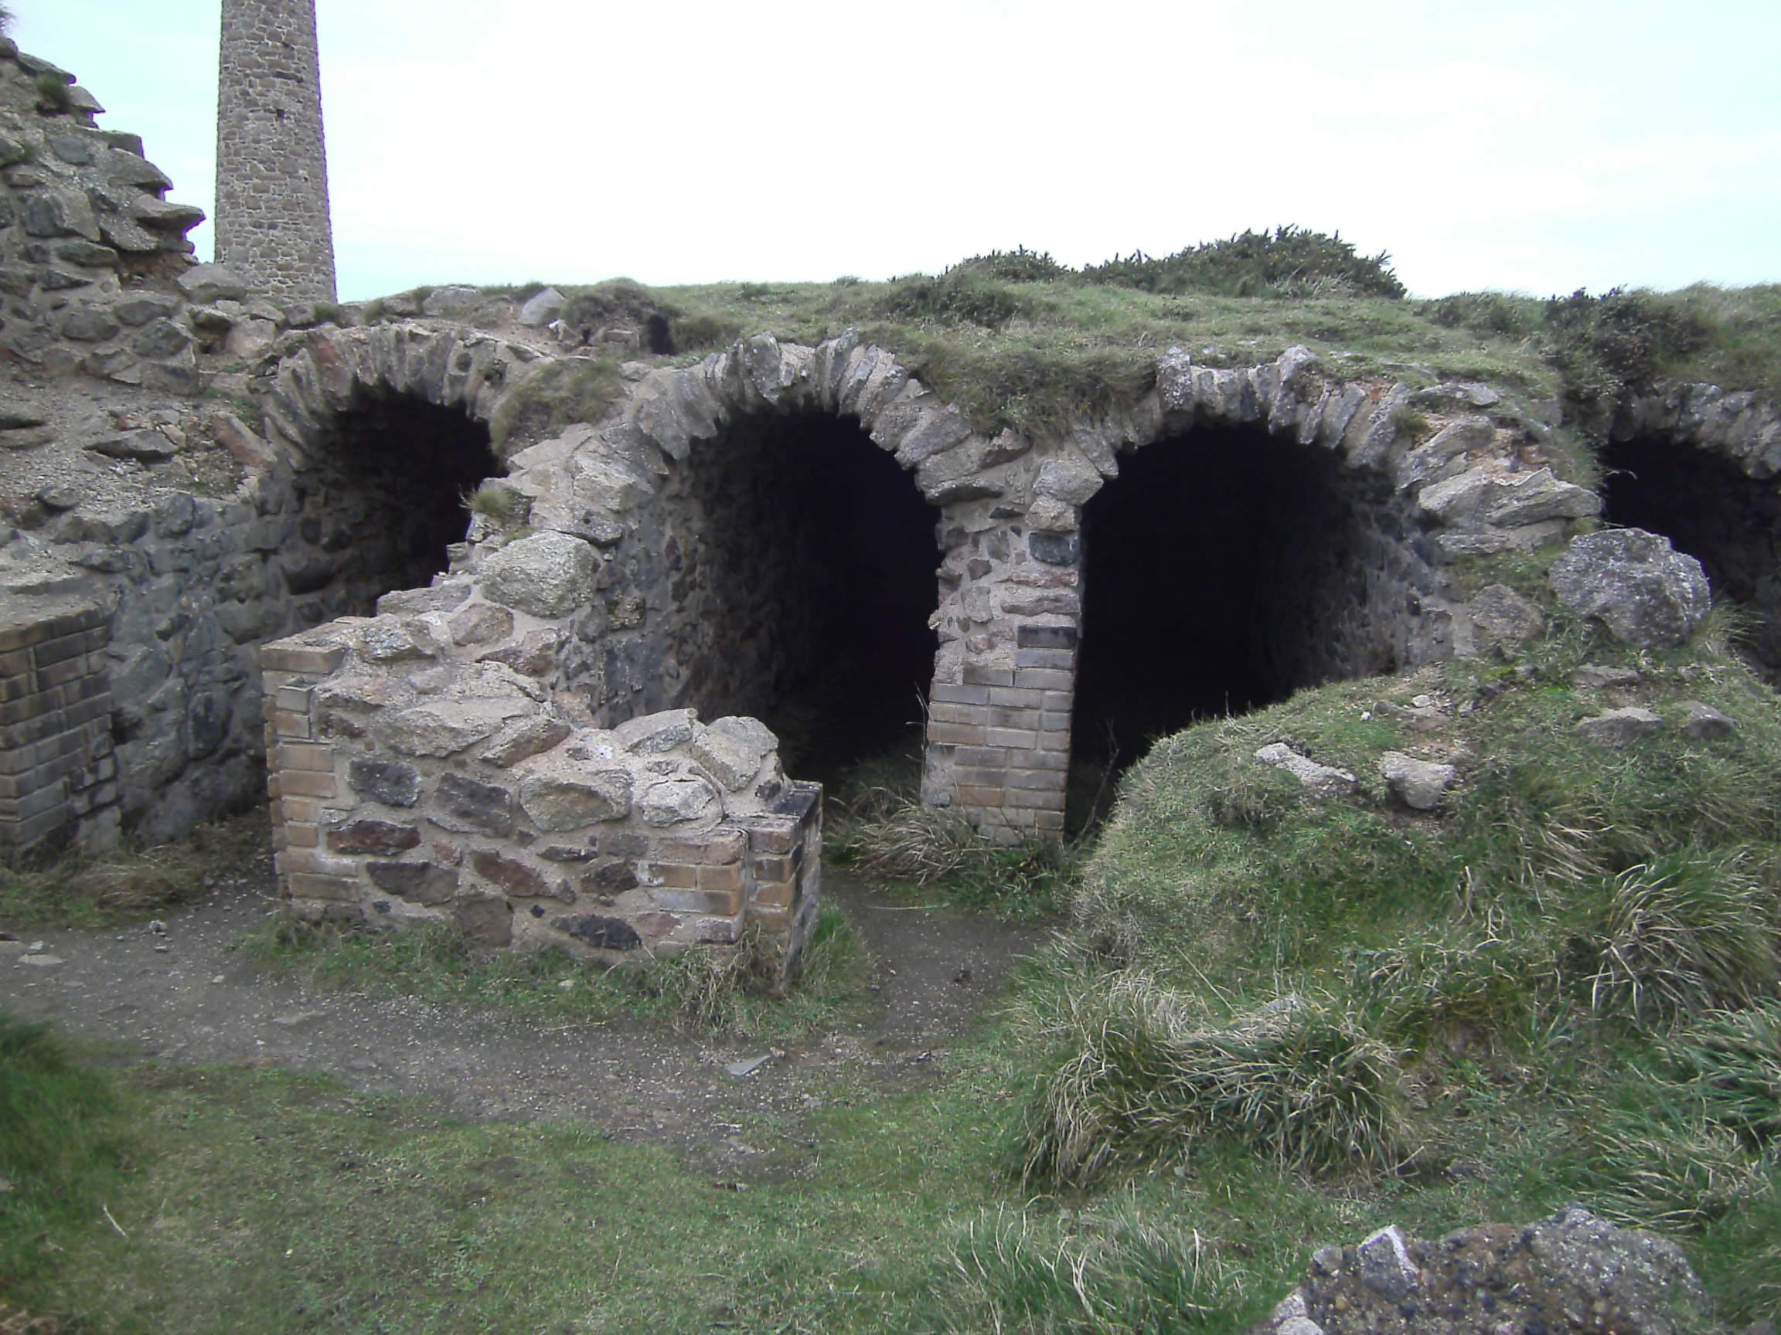
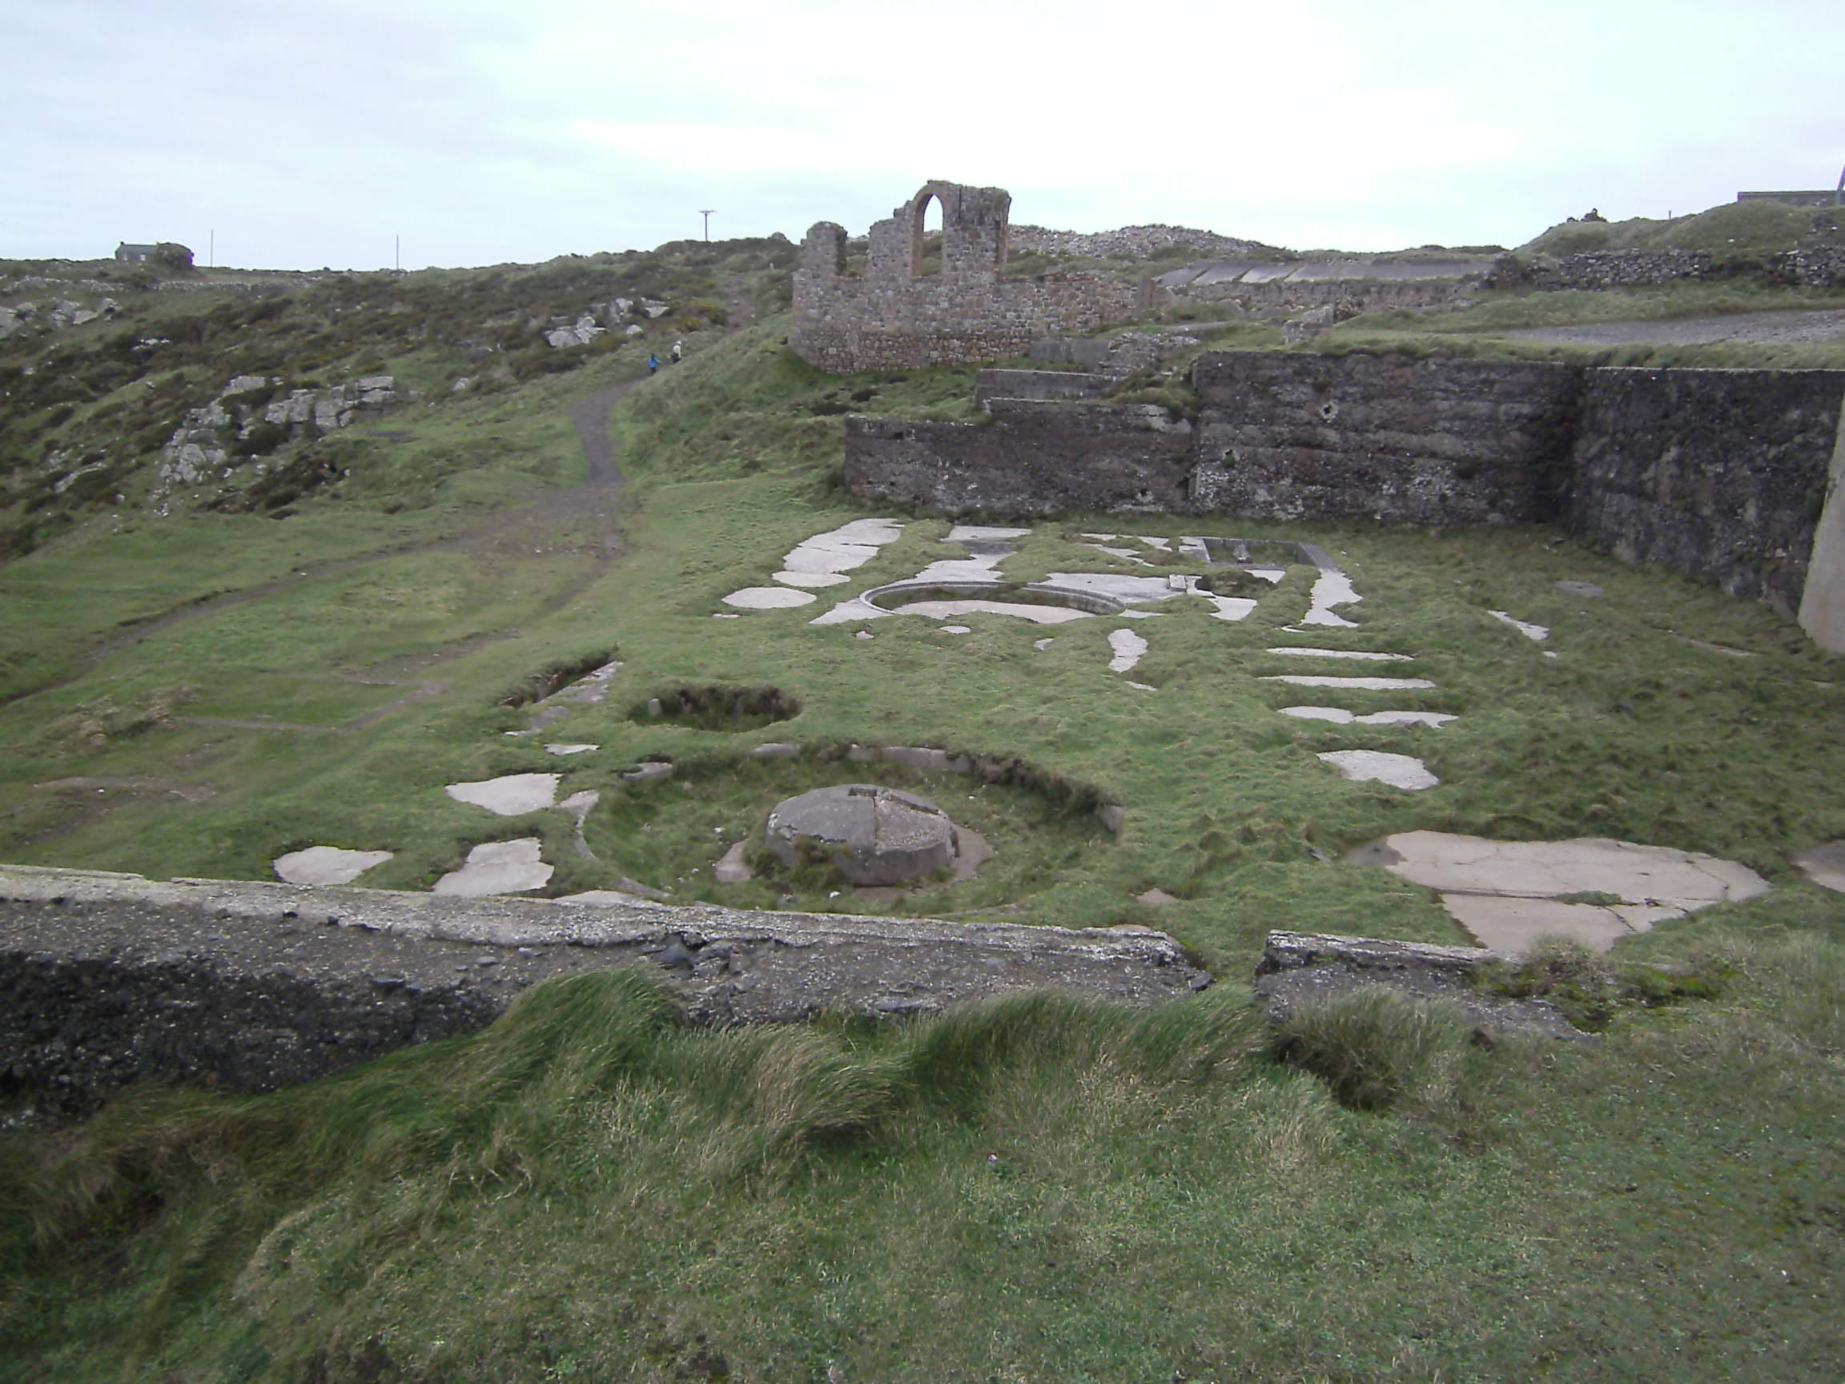
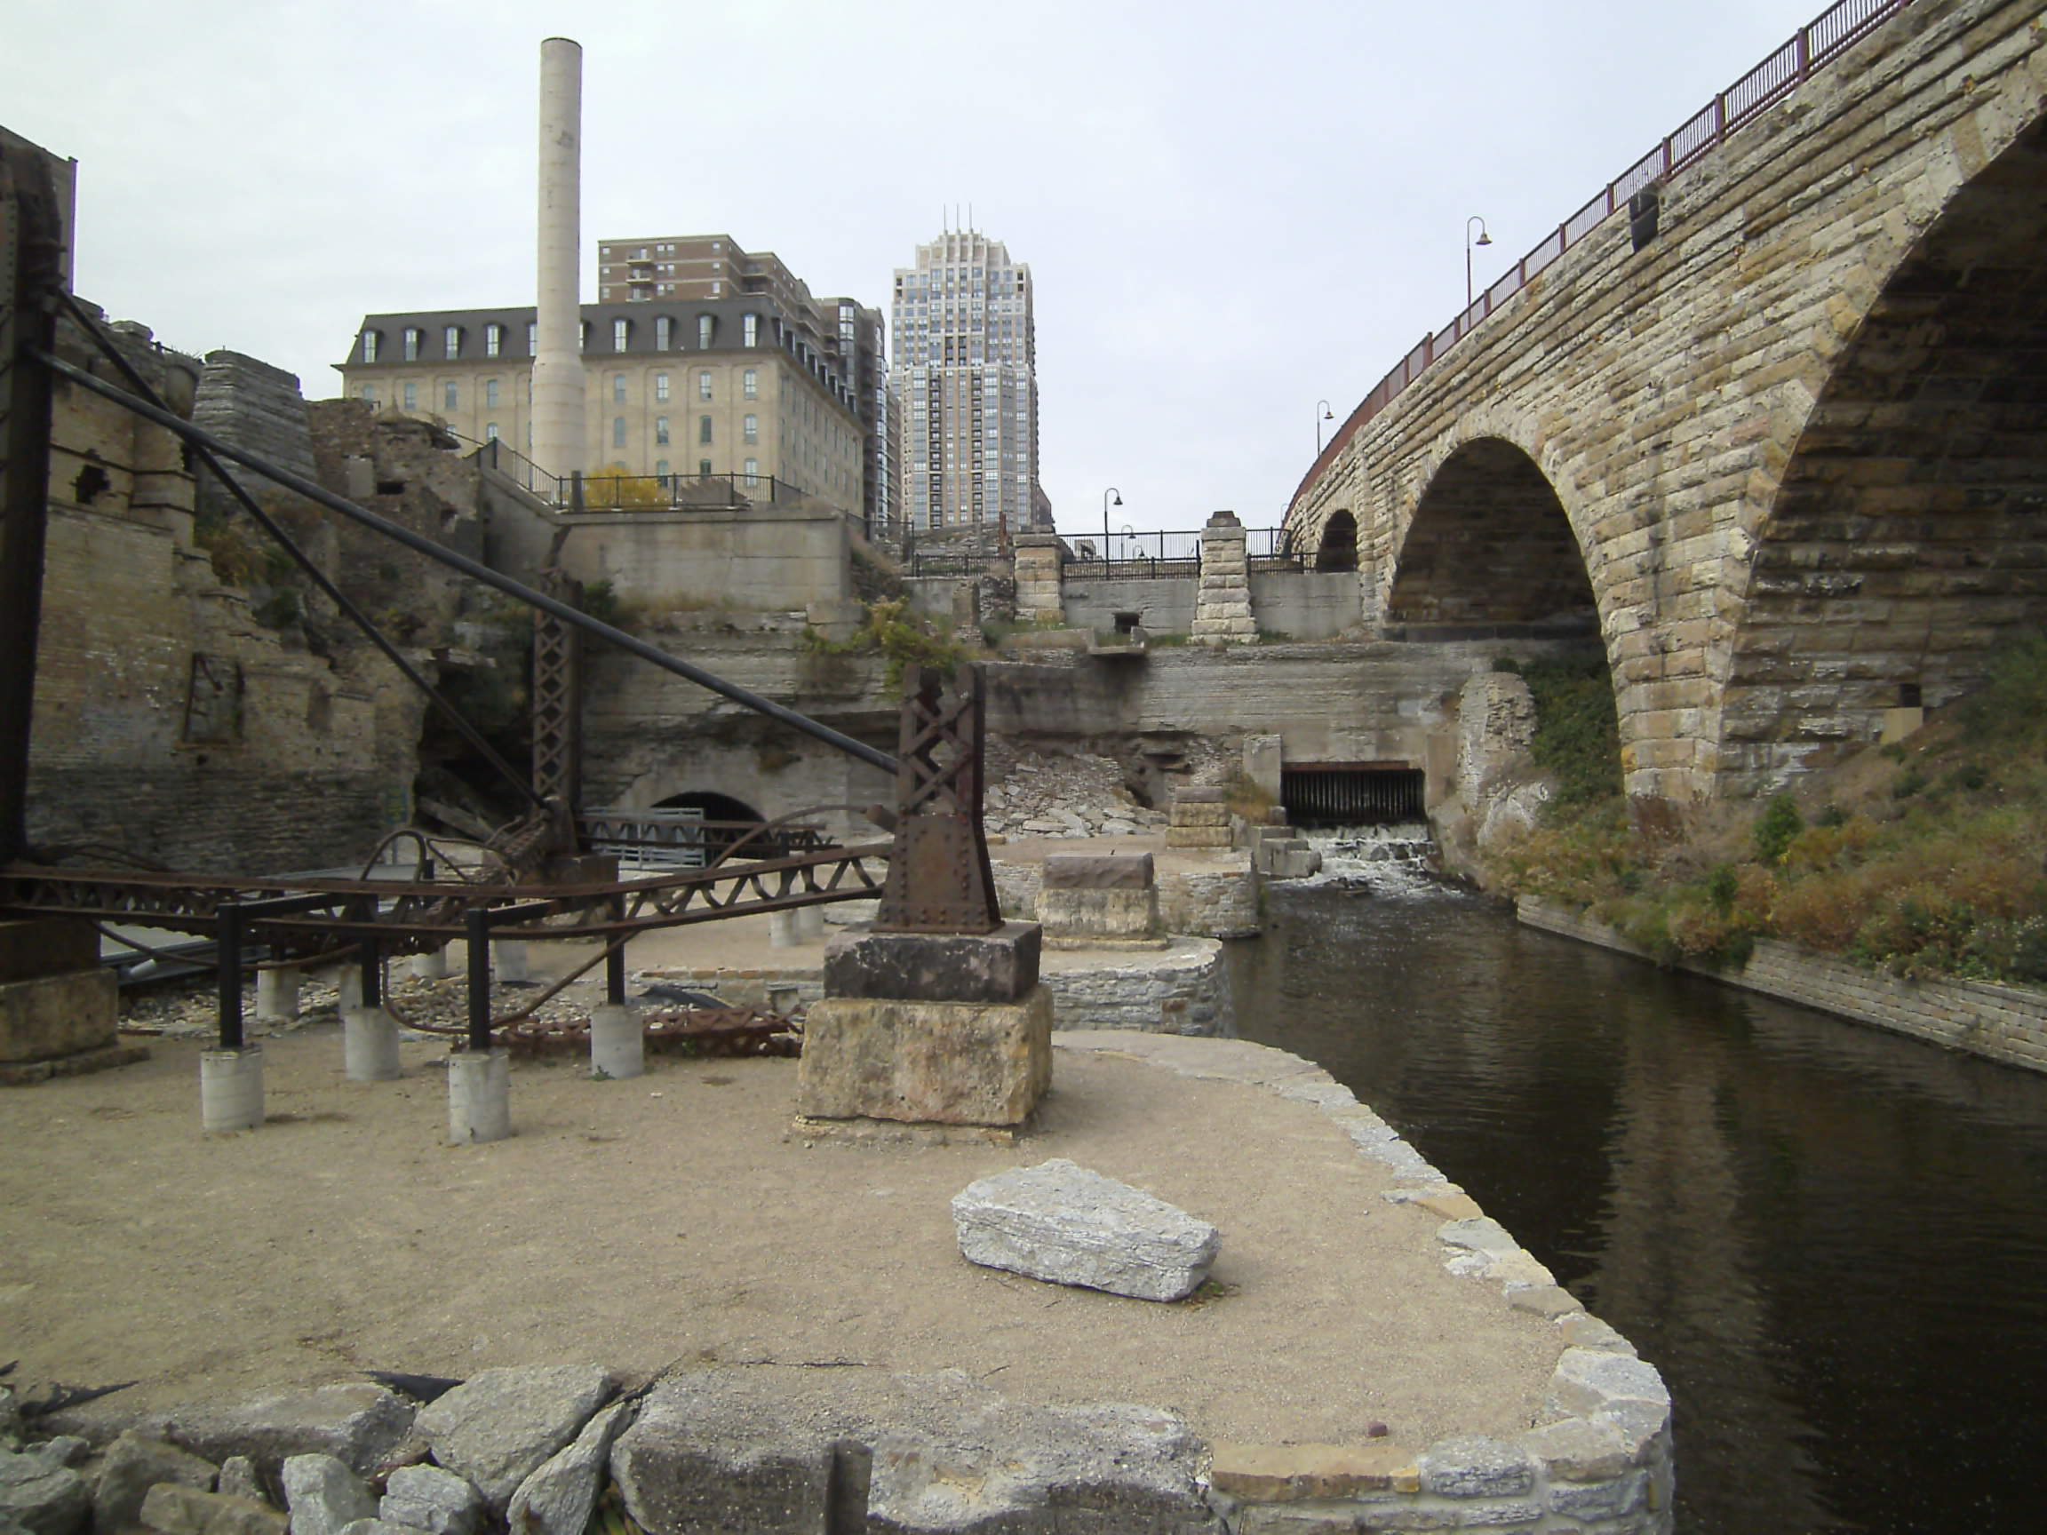
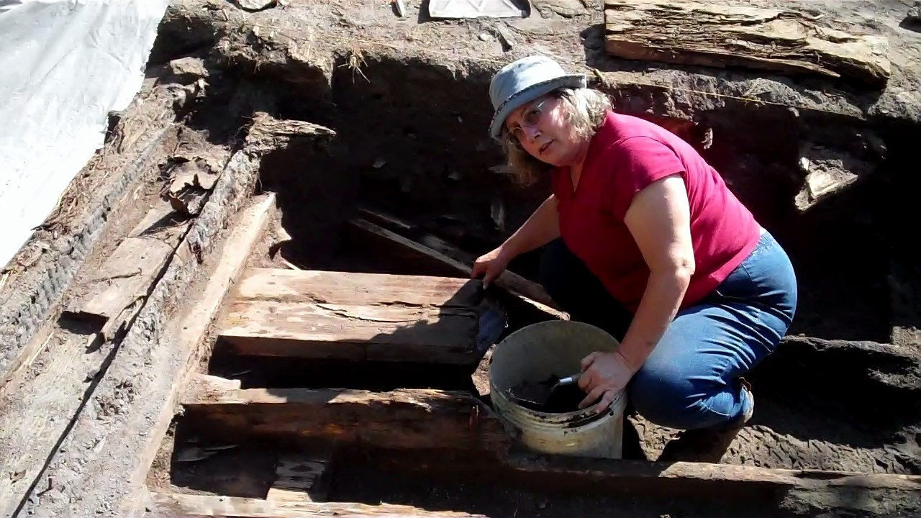
Industrial archeology
Keewenaw
Cornwall
Cornwall
Minneapolis

Slide 15
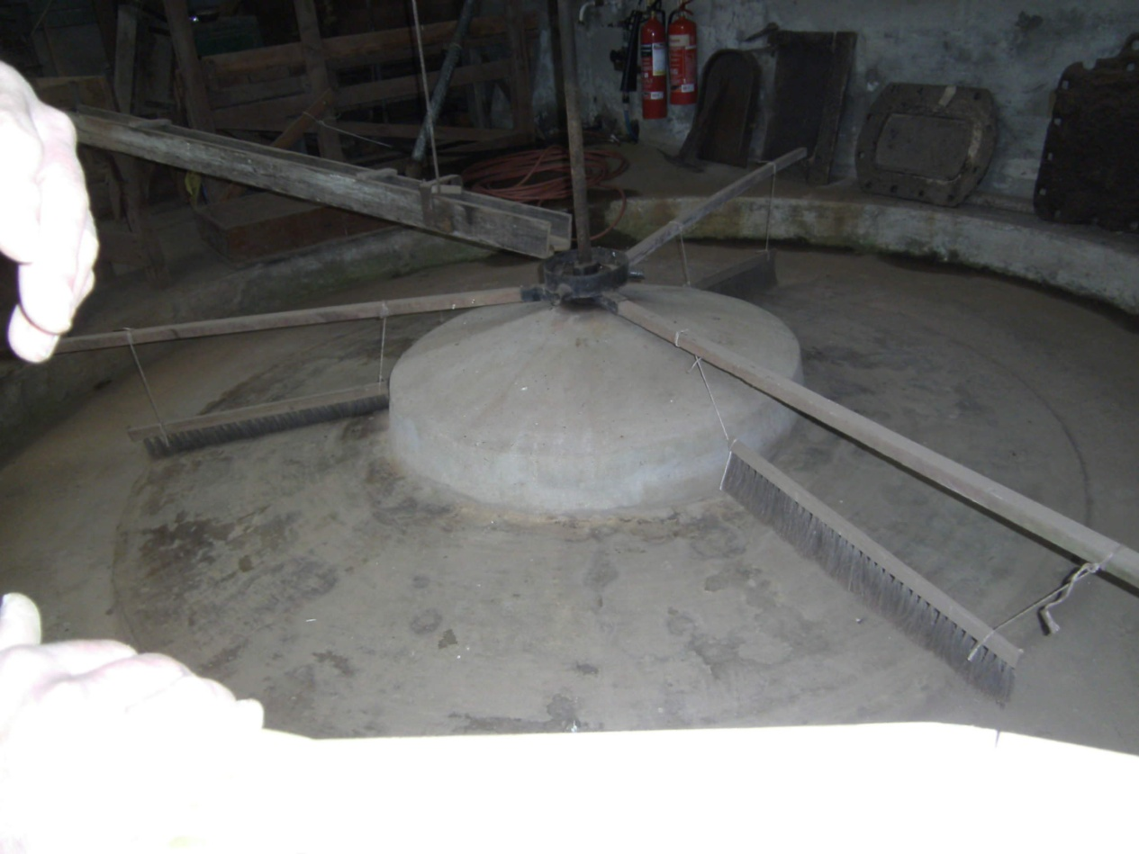
Stamp mill - industrial archeology
Keweenaw
Buddles?

Slide 16
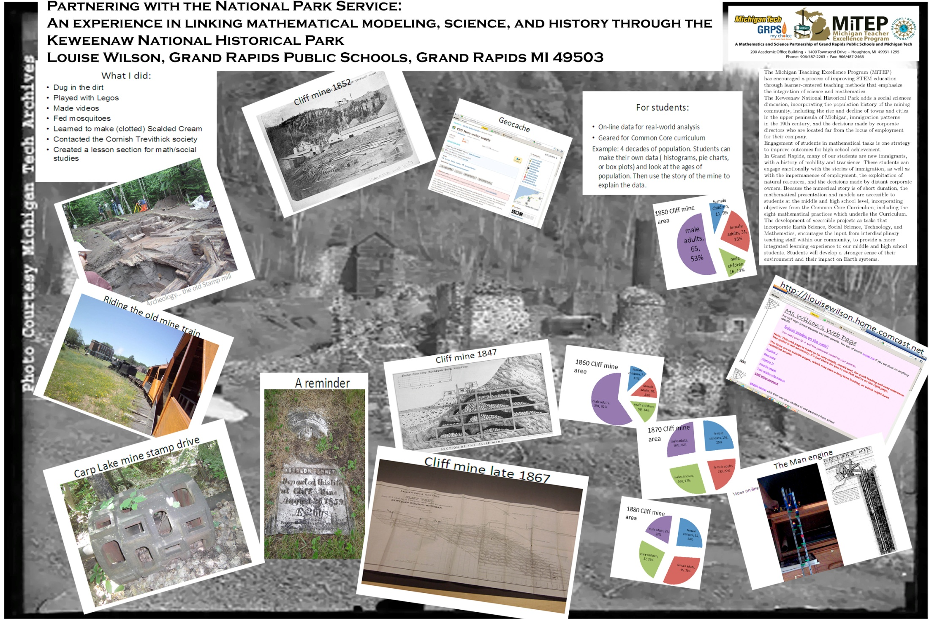

Slide 17
Links
http://cliffmine.wordpress.com/
http://jlouisewilson.home.comcast.net
http://popular-archaeology.com/issue/september-2011/article/looking-deeper-into-cliff-mine
http://www.keweenawhistory.org/Sites/Eagle_River.html
http://www.nps.gov/kewe/index.htm
http://mitep.mspnet.org/#
http://www.kingedwardmine.co.uk/

Slide 18
Thank you
Michigan Tech
National Trust (U.K.)
Grand Rapids Public Schools
King Edward mine (U.K.)

